Slide 1
Time Line of Events
The United States: 1800- Civil War… at a glance

Slide 2
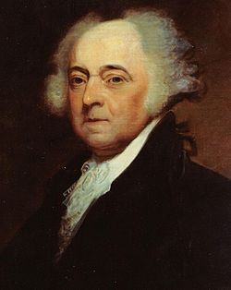
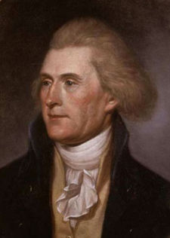
John Adams elected 2nd president
1801
Thomas Jefferson elected 3rd president

Slide 3
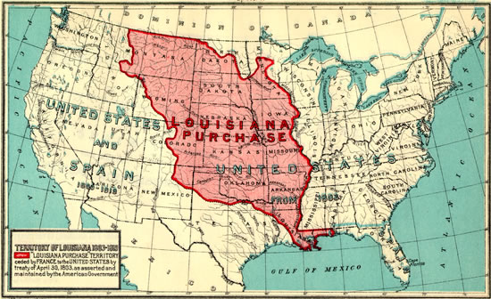
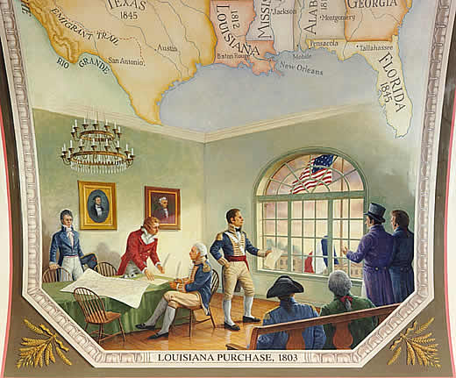
Jefferson instructed James Monroe to inquire as to the purchase of New Orleans. The French responded with an offer for “the entire Louisiana.”
1803: The Louisiana Purchase effectively doubles the size of the United States

Slide 4
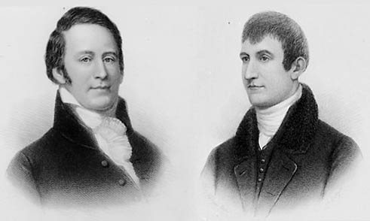
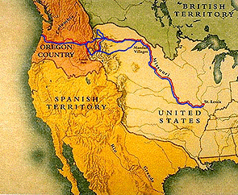
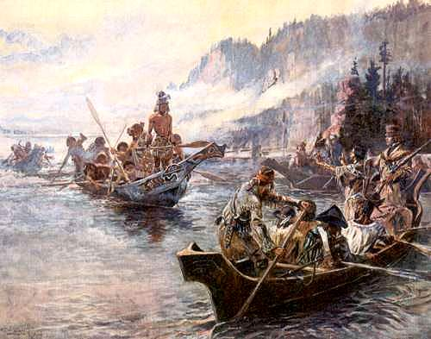
Meriwether Lewis and William Clark are sent to explore the newly purchased territory. They map their trip and record many new plant and animals.
1804: Lewis and Clark explore

Slide 5
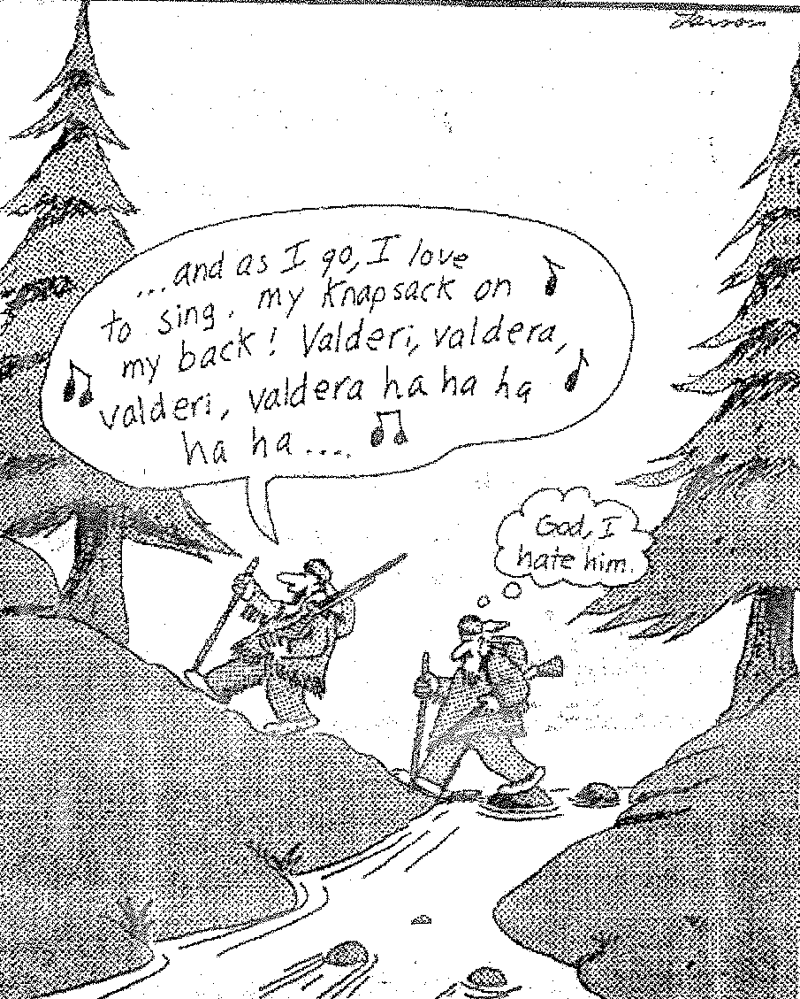

Slide 6
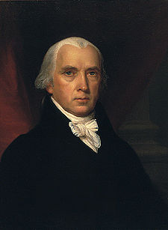
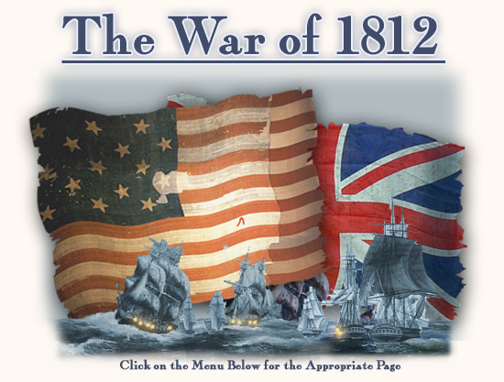
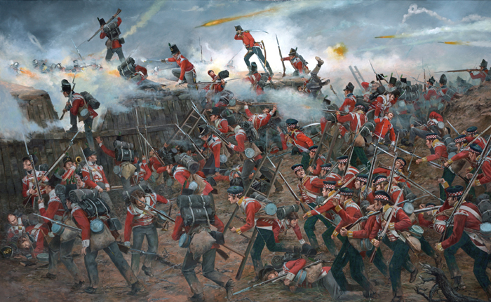
1808: James Madison is elected president.
America once again enters a war with Great Britain: The War of 1812

Slide 7
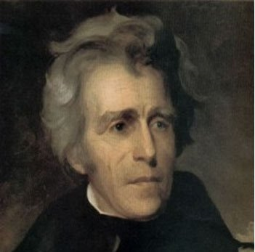
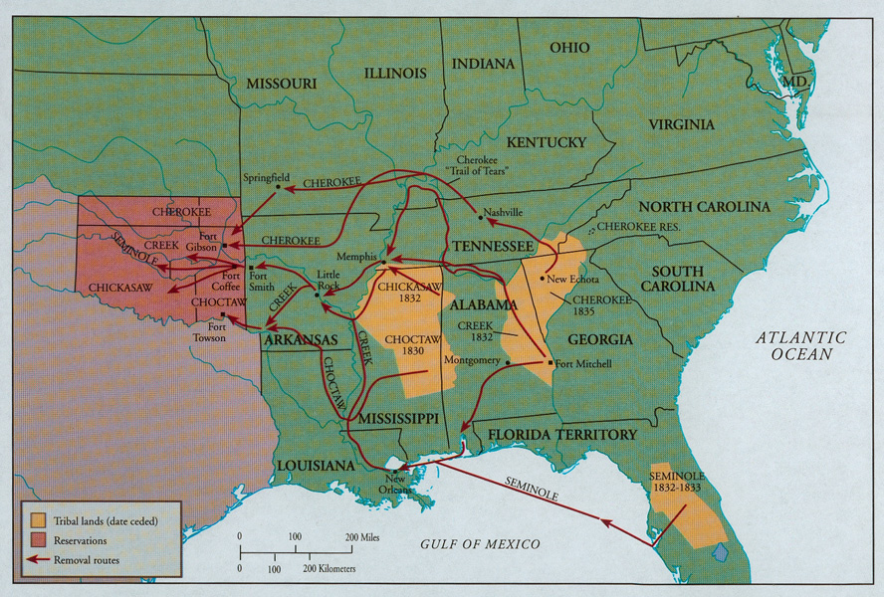
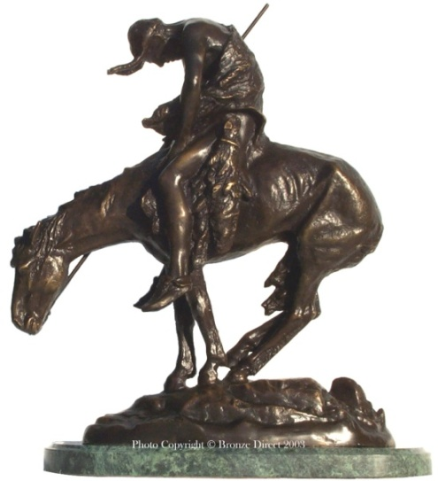
1828: Andrew Jackson, military hero of the
War of 1812 is elected president.
Under the direction of Jackson, Congress passes the Indian Removal Act in 1830. In 1838 the Cherokee and the other “Five Civilized Tribes” are forcibly removed from their homeland to Indian Territory. This is known as the Trail of Tears.

Slide 8
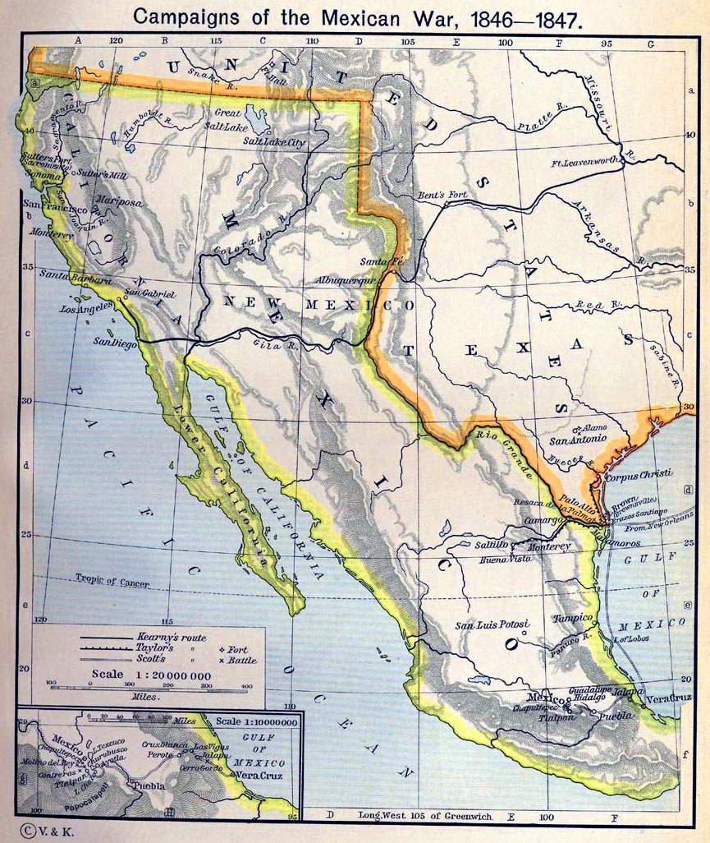
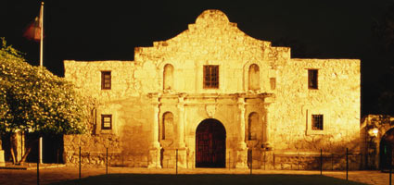
Texas fights and wins its independence from Mexico. “Remember the Alamo” becomes a military war cry.
1846: The Mexican War begins. Large portions of the Southwestern United States are acquired in exchange for $15 million.

Slide 9
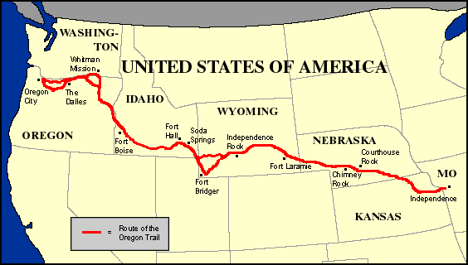
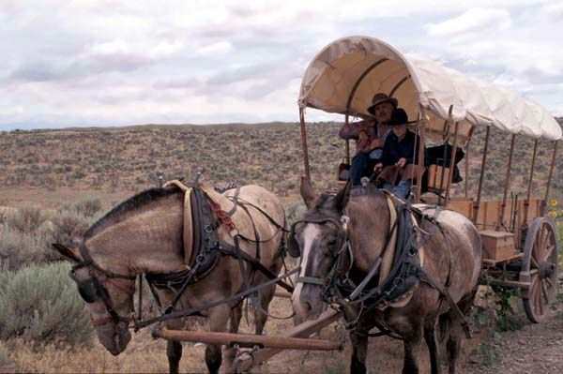
1840-1860:
The Oregon Trail
Over 350,000 people trekked over 2,000 miles across the plains to the coast to settle in the Northwest. Most settlers departed from Independence, Missouri. Wagon trains were formed and the ruts of the wagons are still visible in various places.

Slide 10
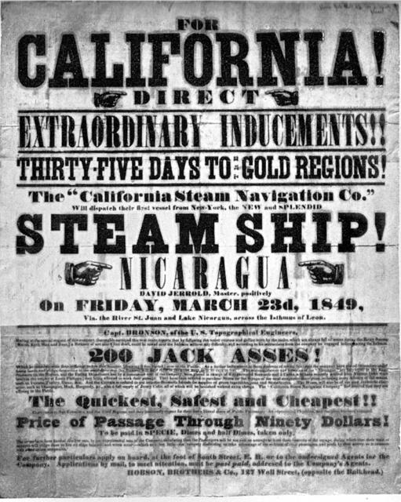
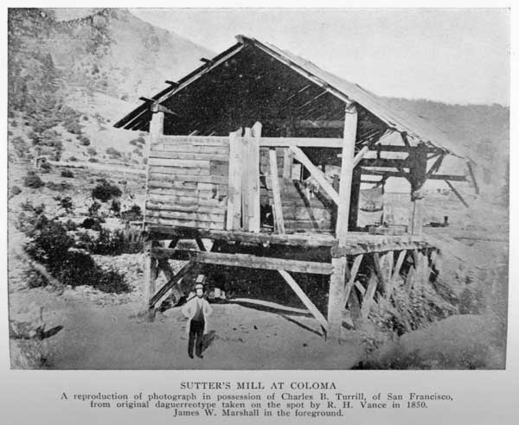
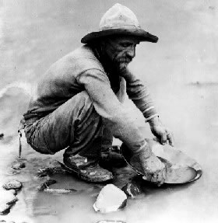
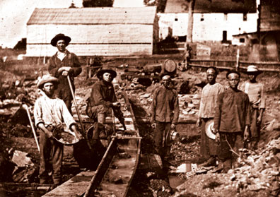
1848: Gold is discovered at Sutter’s Mill in California setting off the “Gold Rush” of 1849 as people quickly came to California in hopes of striking it rich. Few did.

