Slide 1
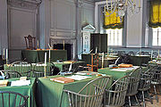
Forming a New Government
Chapter 10

Slide 2
Articles of Confederation
*first official government of the United States
*created a “firm league of friendship”
* weak central government made it ineffective as it could not enforce laws

Slide 3
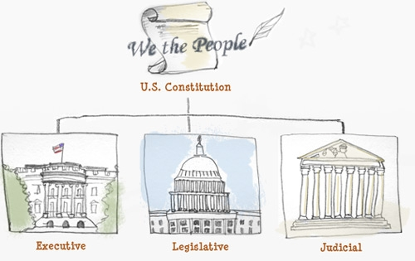
ratify- to officially approve
*legislative branch- makes laws
*executive branch- enforces laws
*judicial branch- interprets laws

Slide 4
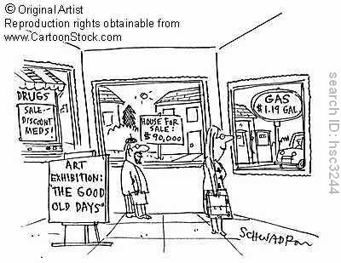
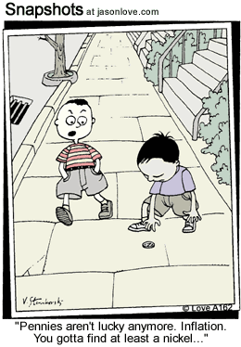
inflation- prices rise faster than income

Slide 5
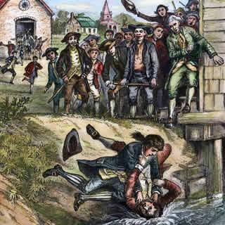
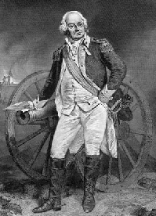
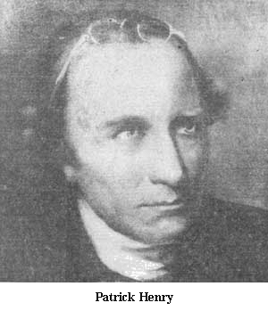
Shays’ Rebellion- led by Daniel Shays, this uprising of angry citizens showed the weakness of the new government as the Articles limited Congress from enforcing any laws created
“Our body politic is dangerously sick” – Patrick Henry’s observations after Shays’ Rebellion
Daniel Shays

Slide 6
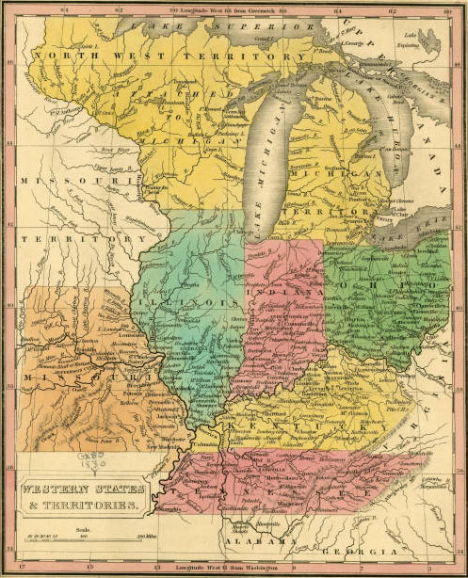
The Northwest Ordinance of 1787- the Articles of Confederation did accomplish setting the procedure and requirements for additional states to be allowed into the Union by establishing a structure pertaining to the Northwest Territory.

Slide 7
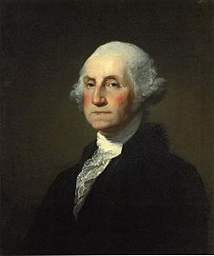
George Washington’s observations concerning the Articles of Confederation:
“Thirteen pulling against each other and all tugging at the head will soon bring ruin on the whole.”
“If the powers of Congress are inadequate, amend or alter them.”

Slide 8
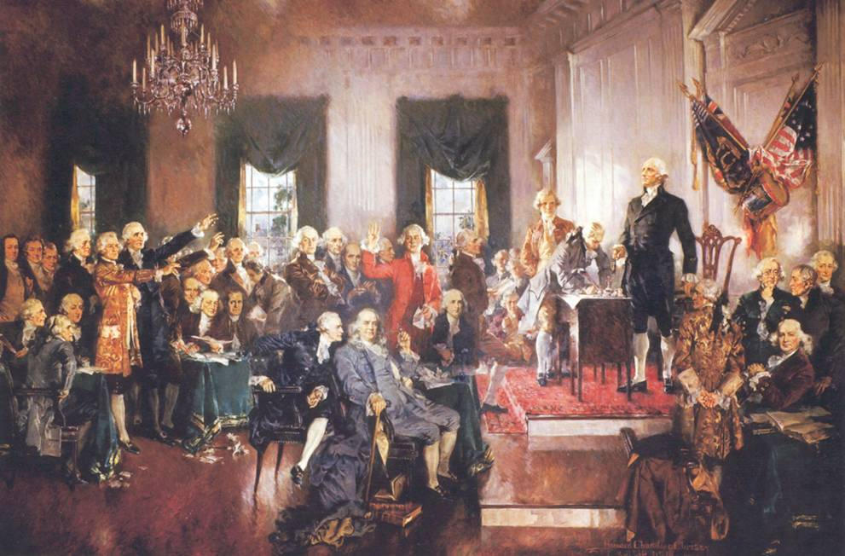
The Constitutional Convention of 1787
was an effort to fix the problems with the Articles. Eventually it was decide d to “abolish” the Articles and create a brand new government: The Constitution

Slide 9
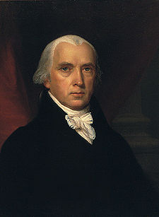
known as “The Father of the Constitution”
*the Convention was basically his idea and he staked his reputation on its success
his notes are the most accurate record of the events which saw the creation of our government
interesting note: he was terrified of public speaking
James Madison

Slide 10
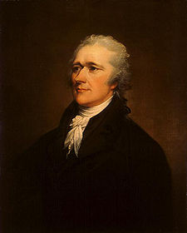
Alexander Hamilton
close personal aide to Washington
well respected attorney in New York
favored a strong central government

Slide 11
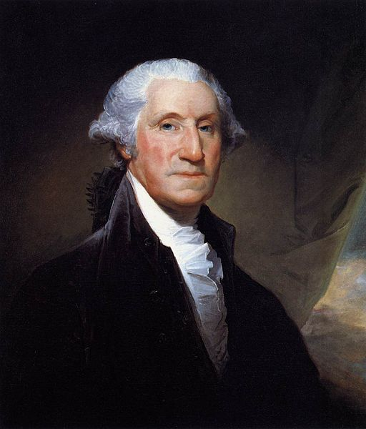
George Washington
served as president of the convention
had to be talked into attending as he was retired from public service

Slide 12
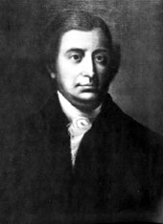
Competing Plans
Virginia Plan
New Jersey Plan
Edmund Randolph- popular governor of Virginia presented the plan
favored by the small states
representation was to be based equally: one state=one vote
* favored by the large states
* representation was to be based on population

Slide 13
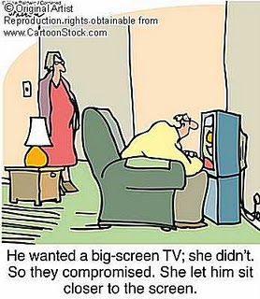
A compromise is when both sides give up something in order to reach an agreement
Compromise

Slide 14
The Great Compromise
*proposed by Roger Sherman, sometimes called the
“Sherman Compromise” or the “Connecticut Compromise”
stated that there would be equal representation in the Senate (which satisfied the small states),
but the House of Representatives would be based on population (which satisfied the large states)

Slide 15
The Three-Fifths Compromise
Background: slave states wanted slaves to count as part of the population for determining representation, but not as part of the population for determining taxes owed
* The Three-Fifths Compromise established that enslaved people would be counted as 3/5 of a population for both representation and leveling taxes. In other words for every five slaves, the state would count three toward their population.
* It also set a date (1808) for stopping the importation of slaves
Without this compromise, the Southern states made clear they would not have confederated into one Union.

Slide 16
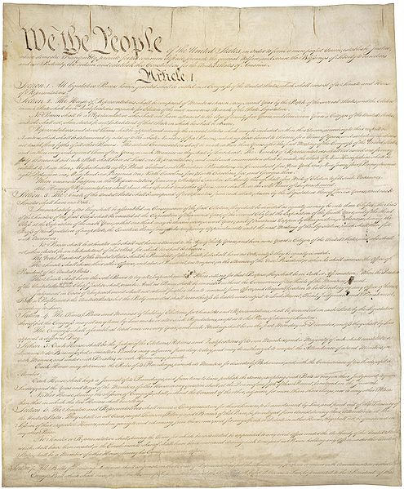
The Constitution
The Constitution is the framework for our country, the supreme law.
It tells precisely how the government is to operate.
It provides all the rules and qualifications for every role in the government

Slide 17
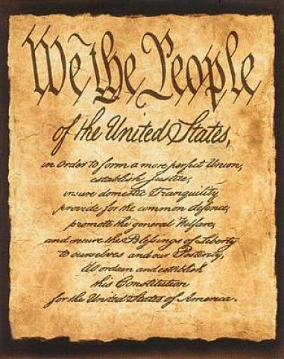
The Preamble
The Preamble is the opening of the Constitution.
It states clearly that our new government is to be run by
“the people”

Slide 18
reserved powers- powers left or “reserved” for the states
in other words, if the Constitution does not state it is the responsibility of the federal government, it is left to the states to decide
separation of powers- sets up the role and responsibilities of each branch of government
in other words, each branch has certain responsibilities and can not infringe on the powers of another branch

Slide 19
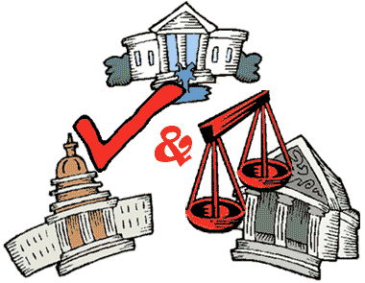
Checks and Balances
a system allowing one branch of government to keep the other branches in “check”, or prohibit them from becoming too powerful
veto- when the president refuses to sign a bill into law

Slide 20
*enforces the laws
* President
*makes the laws
Congress
*Senate
*House of Representatives
interprets the laws
Supreme Court

Slide 21
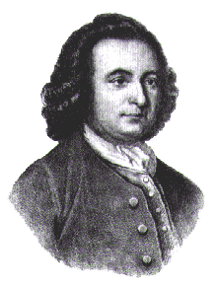
“I’d sooner chop off my right hand that put it to the Constitution as it now stands.”
Mason was worried that there was no Declaration of Rights included. Others felt it wasn’t necessary since each state already had one and reserved powers left that to the states
Col. George Mason
this was indicative of problems getting the Constitution ratified

Slide 22
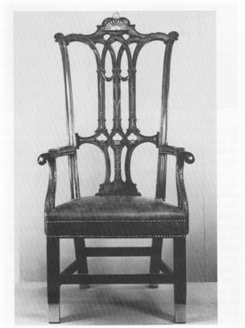
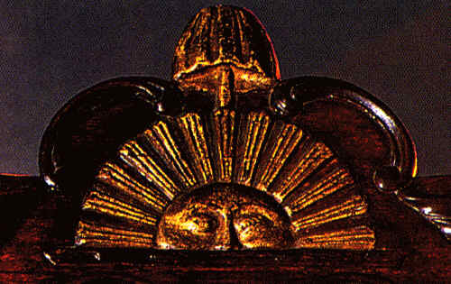
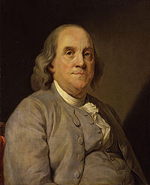
Benjamin Franklin cried tears of joy when it came time to sign the Constitution. He explained, “I have often looked at that sun behind the president of the convention without being able to tell whether it was rising or setting. But now, I have the happiness to know that it is a rising and not a setting sun.”
He then said , “I consent…to this Constitution because I expect no better.” Then added, “And I am not sure that it is not the best.”

Slide 23
Federal- a “national” or “central” government
Federalist- one who supported the Constitution
Federalists supported a strong central Government
Antifederalists- did not support the Constitution

Slide 24
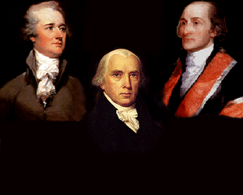
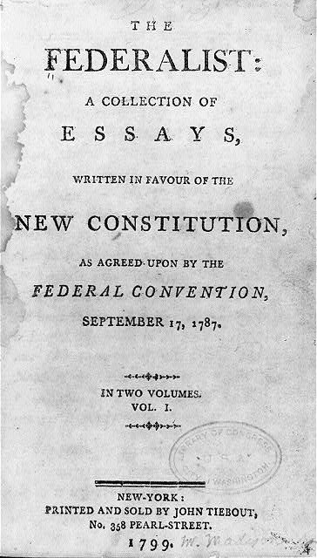
John Jay
Alexander Hamilton
James Madison
The Federalist was a collection of essays written to persuade people to ratify the Constitution.

Slide 25
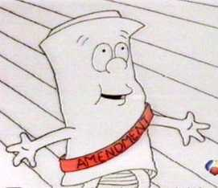
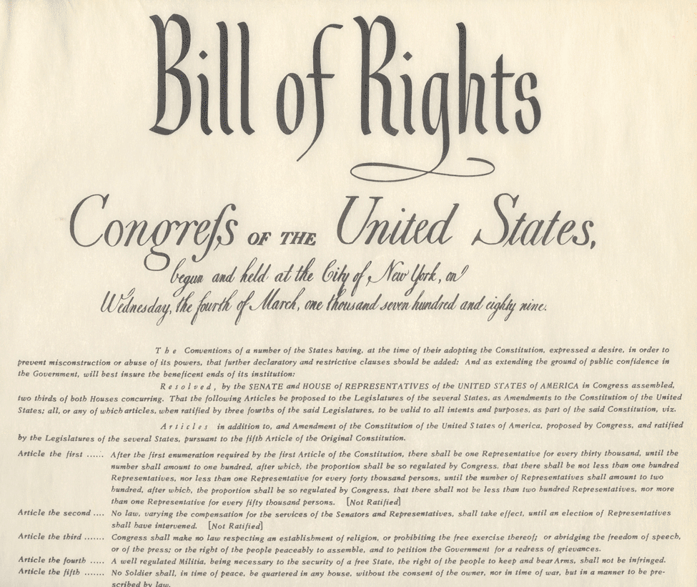
Amendment- an addition, or change , to the Constitution
The first 10 amendments to the Constitution
these amendments guarantee that our basic rights can not be inhibited, or taken away, by the government. As Jefferson said in the Declaration of Independence, they are “unalienable”

Slide 26
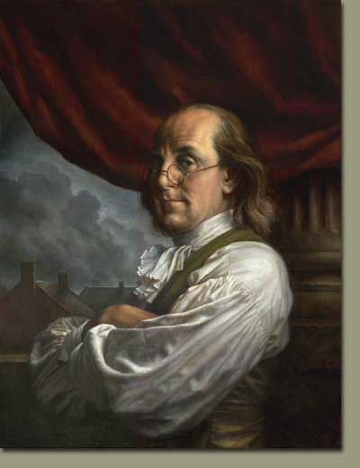
“A republic, if you can keep it.”
Benjamin Franklin
The Constitution allows “the people” to govern themselves, but it requires responsibilities of all citizens in order to continue to guarantee the freedoms and rights we enjoy.

