Slide 1
A Divided Nation

Slide 2
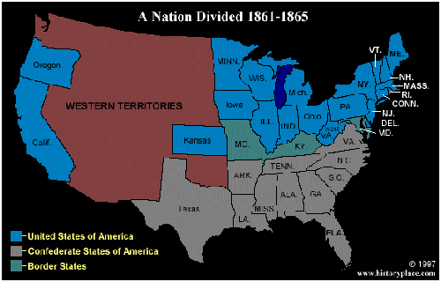
North and South Grow Apart
sectionalism- loyalty to a “section” or region of a country rather than a whole country

Slide 3
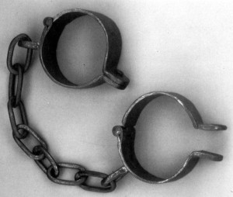
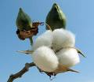
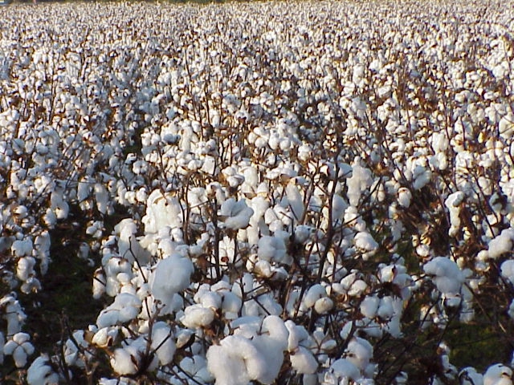
Slavery in the south
The economy of the South had developed based on agriculture. Large plantations growing cash crops such as indigo, rice, tobacco, and eventually cotton, were dependent on slave labor.

Slide 4
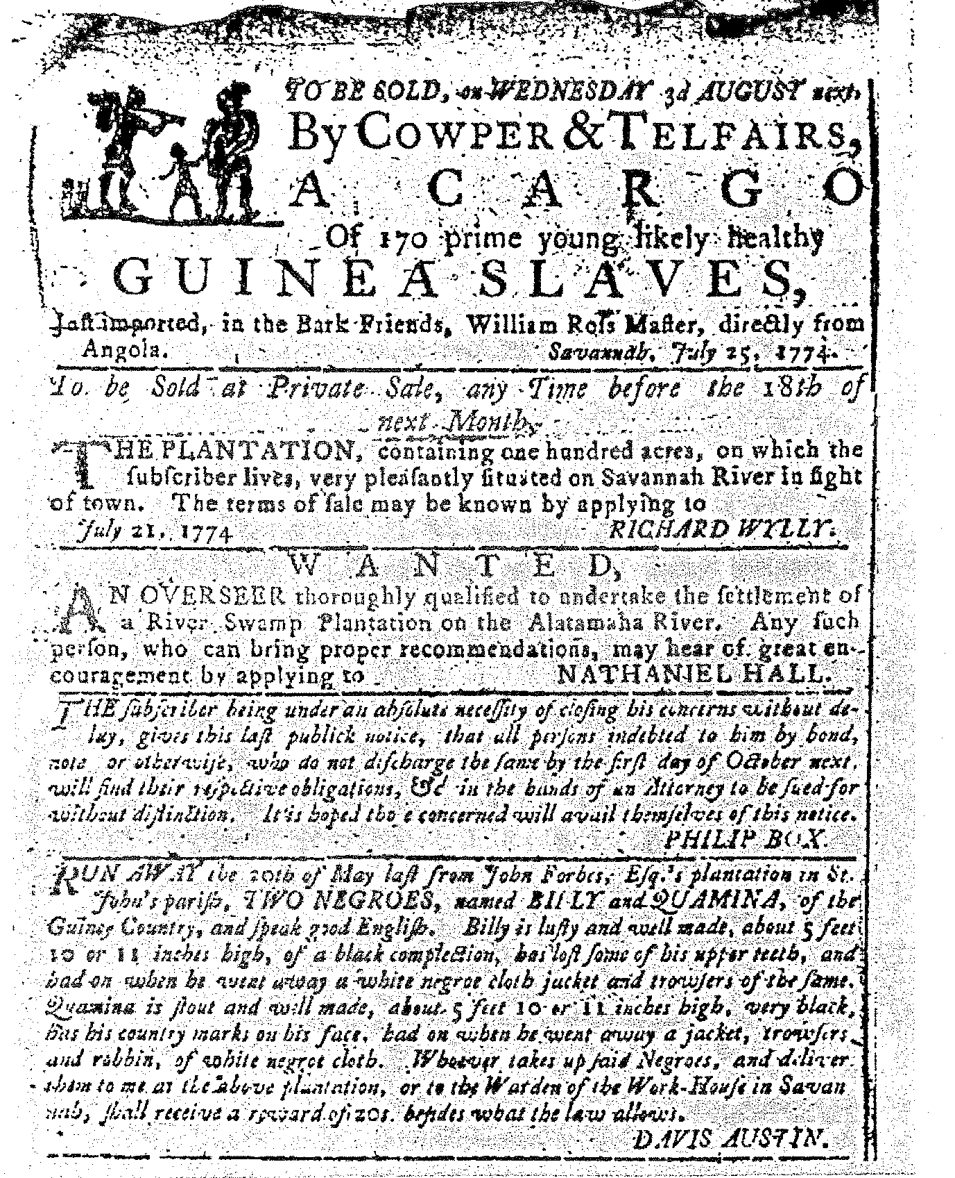
Advertisements concerning slavery

Slide 5
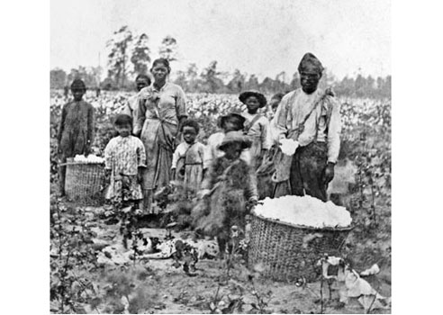
Resisting slavery
Slaves resisted slavery in many ways: working slowly, breaking tools, feigning sickness, and escape
slave codes- laws passed as a means of controlling slaves. These included forbidding travel, marriage, and even forbidding the teaching of reading
slave rebellion- occasionally rebellions occurred, but were always put down viciously. Afterwards, slave codes would be strengthened.

Slide 6
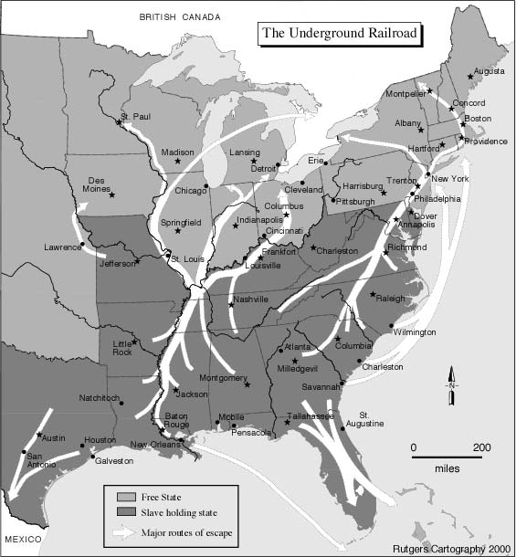
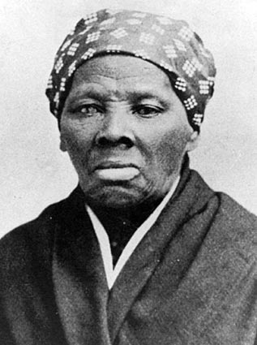
The Underground Railroad
Not a real railroad. It was a loosely organized system of safe houses that helped slaves escape north to freedom
Harriet Tubman
also known as “Moses” for leading so many people to freedom

Slide 7
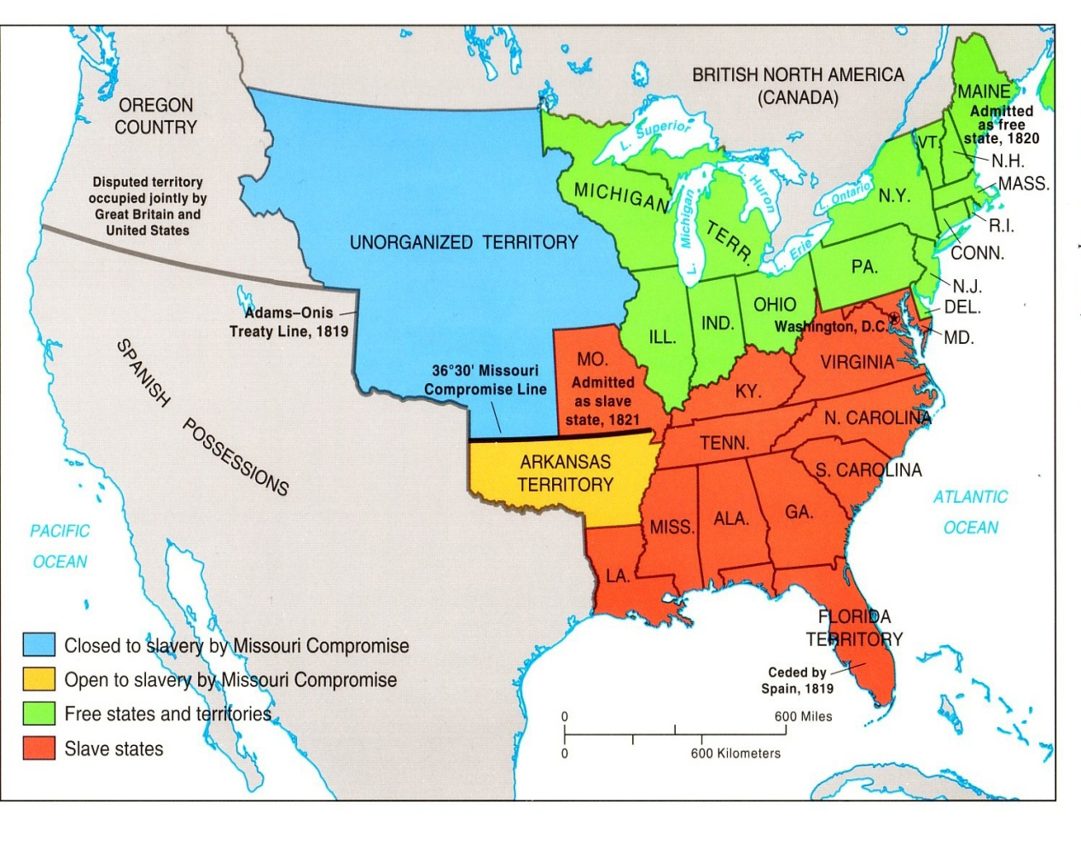
The Struggle over Slavery
Various compromises were made over time in an effort to appease both sides of the issue and avoid war.
The Missouri Compromise
Admitted Missouri as a slave state and Maine as a free state in 1820 in an effort to keep the balance between the two

Slide 8
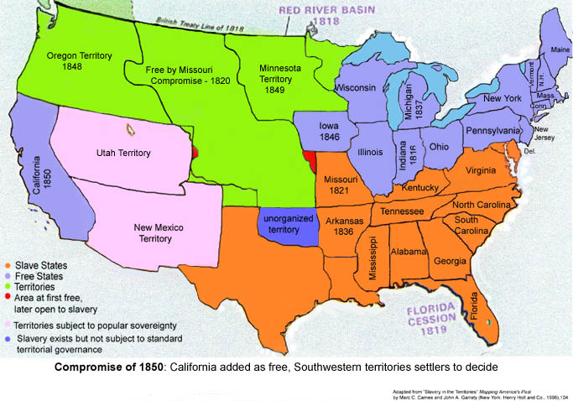
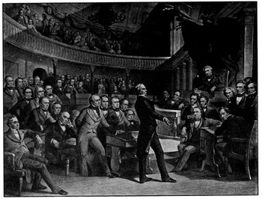
The Compromise of 1850 allowed California to enter as a free state. In return the North would promise to support the Fugitive Slave Law.
The Compromise of 1850
Fugitive Slave Law- required all escaped slaves to be returned to their owners, even if they had reached freedom.

Slide 9
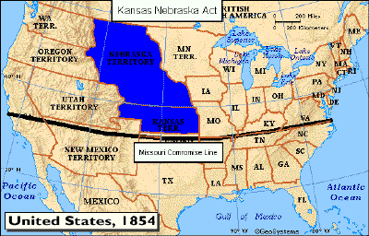
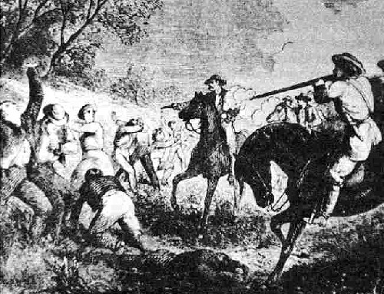
Kansas-Nebraska Act
A compromise plan to allow voters in the Kansas Territory and Nebraska Territory to determine if they would be free or slave
Bleeding Kansas
The unfortunate nickname given to Kansas as there was so much fighting between pro slavery forces and abolitionist

Slide 10
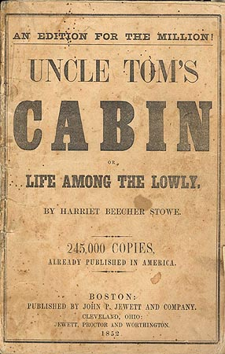
A Divided Country
Harriet Beecher Stowe wrote Uncle Tom’s Cabin which described the cruelties of slavery and caused the nation to rethink its views on the matter.

Slide 11
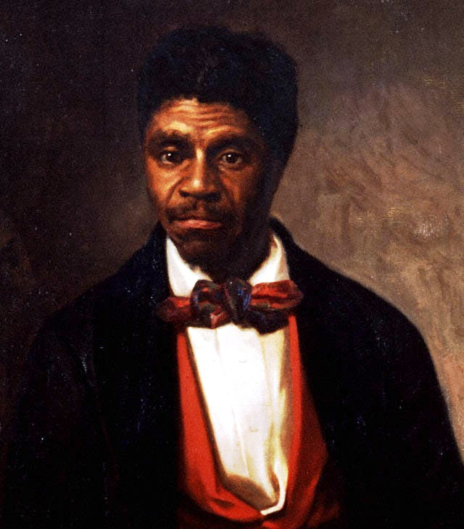
Dred Scott sued for his freedom based on the fact that he had lived in a free state and a free territory. The Court’s ruling that he was property and therefore had no rights as he was not a citizen. The decision touched off a firestorm of debate concerning slavery in general.

Slide 12
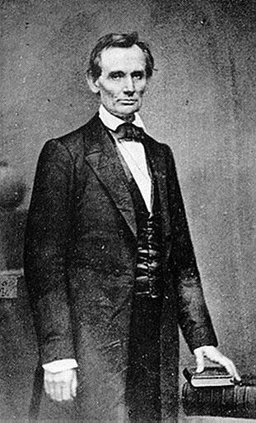
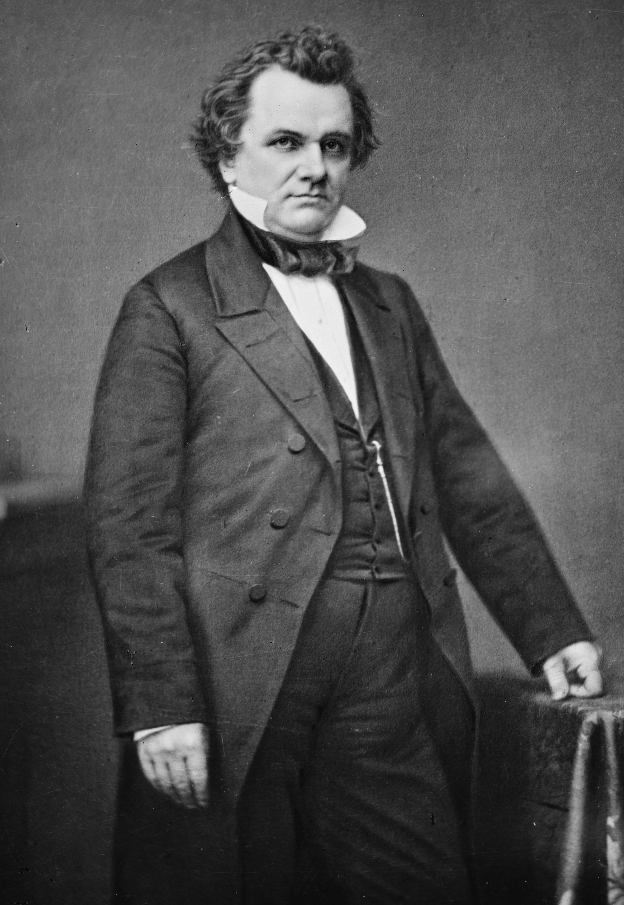
Abraham Lincoln gained fame from his debates against Stephen Douglas. His most famous being the charge, “A house divided upon itself can not stand.”
Stephen Douglas
Lincoln is nominated as the presidential candidate for the newly formed Republican Party. Several southern states threaten to “secede” if he is elected….he is, and they do.
“If slavery is not wrong, then nothing is wrong.” Abe Lincoln
Abraham Lincoln

Slide 13
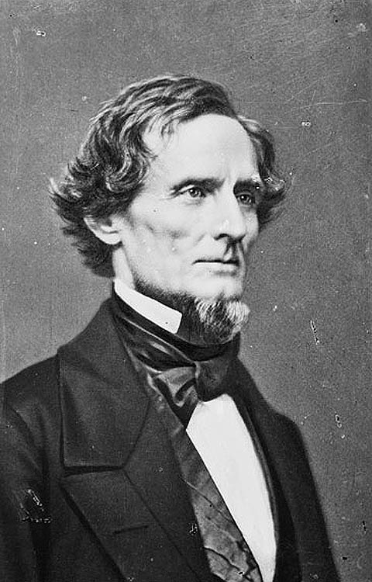
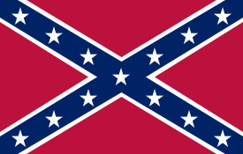
The first shots are fired
Confederate States of America, or “the Confederacy” was the name given to the states that seceded from the Union in order to form their own country.
Jefferson Davis former Mississippi senator was elected president of the Confederacy
secede- to break away

Slide 14
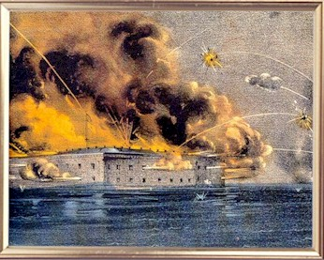
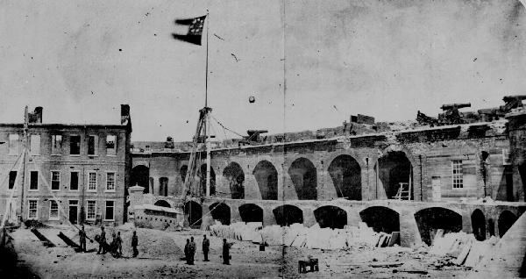
Fort Sumter was still under Union control when the Confederacy fired upon it. This was considered the beginning of the United States Civil War.
photograph of Fort Sumter after the battle.

Slide 15
Civil War
border states- states that bordered the Union and Confederacy. They refused to supply troops to defend the nation, but did not secede.

