Slide 1
The road to the revolutionary war
Chapter 8

Slide 2
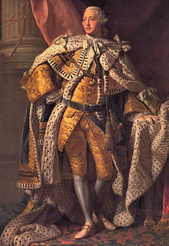
King George III parliament
Britain king that supported taxing the colonists
Britain’s law-making assembly

Slide 3
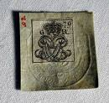
Stamp act “no taxation…”
Law that placed taxes on printed materials such as legal documents, newspapers, playing cards
“No taxation without representation”
Since colonists never voted in Parliament, they complained that Parliament had no right to tax them

Slide 4
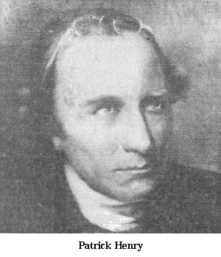
patrick henry repeal
Lawyer that was one of the first to speak out against the Stamp Act
inspired others to protest
famous for speeches about colonists rights
to cancel or get rid of a law

Slide 5
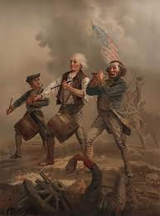
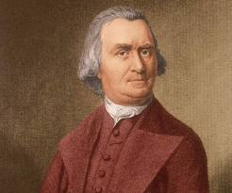
Samuel adams Sons of liberty
Boston Patriot leader
Inspired others to take action
Protested Stamp Act
Organized the Sons of Liberty
Group of Patriots who worked to oppose British rule before the American Revolution

Slide 6
townshend acts
A tax on imported goods like paper, wool, tea, and other goods the colonies imported from Britain
Why? So the King could get money to show the colonists that he was in charge
Who? Charles Townshend, treasurer of British government
When? After the Stamp Act in 1767

Slide 7
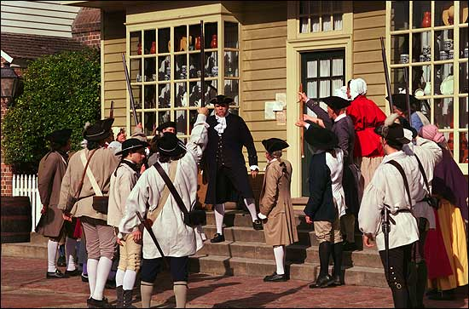
tariff boycott
A tax on imported goods
Refusal to buy goods

Slide 8
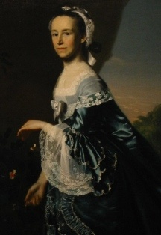
daughters of liberty
Groups of American women Patriots who wove cloth to replace boycotted British goods & made own tea
Mercy Otis Warren

Slide 9
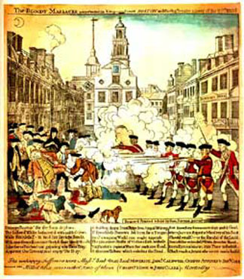
Boston massacre
A massacre is the killing of many people who cannot defend themselves.
March 5, 1770 – British soldiers killed 5 colonists who were part of an angry group that had surrounded them.
Crispus Attucks was a free slave who was killed in BM.
John Adams (Sam Adam’s cousin/2nd President) defends the soldiers and they are found not guilty.

Slide 10
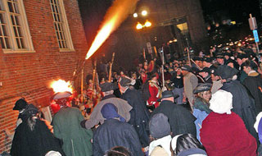
Boston Massacre timeline of events
Next, a crowd of angry colonists in Boston jeered at a British soldier and threw snowballs at him
Finally, someone yelled, “Fire” and the soldiers shot their guns. Five colonists were killed.
First, Great Britian sent troops to the colonies to collect taxes. This angered the colonists.
Then, more British soldiers arrived and the crowd grew larger.

Slide 11
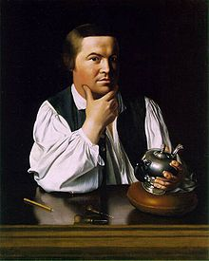
Committees of correspondence & Paul Revere
Committees of correspondence
Paul Revere
Groups of colonists formed in the 1770’s to spread news quickly about protests against the British & local events.
Formed by Samuel Adams
Patriot express rider

Slide 12
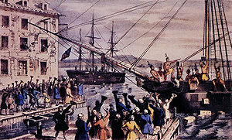
Tea Act
Boston tea party
Two goals:
1. East India Co. only company to sell tea to colonists.
2. Get colonists to pay taxes to Britain
In response to the Tea Act
Sons of Liberty dressed up like Mohawks and dumped the tea into the harbor

Slide 13
intolerable acts
Laws passed by British Parliament to punish the people of Boston for the Boston Tea Party
1. Colonists were ordered to feed and house the soldiers.
2.The colony of Massachusetts was put under the control of a British general named Thomas Gage.
3. Forbidden to assemble
4. The port of Boston was closed until they paid for the tea that was destroyed.

Slide 14
patriots
loyalists
American colonists who opposed British rule
Colonists who remained loyal to King George and British government

Slide 15
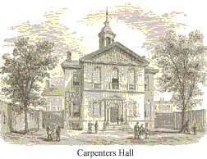
first continental congress
In Sept 1774, representatives from every colony except Georgia met FCC in Philadelphia.
Voted to stop all trade with Britian until the Interable Acts were repealed
Also agreed to begin training militias and to meet again in one year

Slide 16
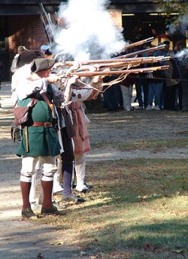
militias
minutemen
localized
volunteer armies
militia groups ready to fight at a moment’s notice

Slide 17
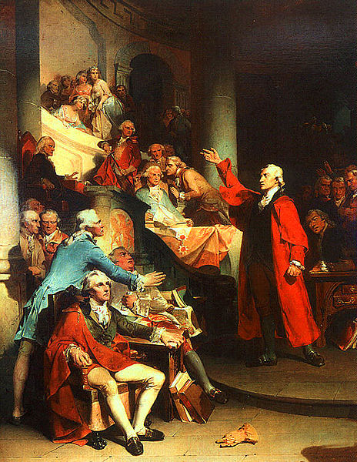
Give me Liberty…or give me Death
Key Points of Speech:
Britain’s actions were akin to slavery
blood had already been shed
the time for talk was over, they were past that point
freedom is worth fighting for, and sometimes worth dying for

Slide 18
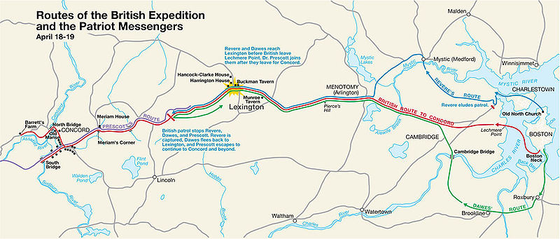
paul revere’s ride
Paul Revere, along with William Dawes and Samuel Prescott were riding to Lexington and Concord to warn colonists that the British were coming.
Revere was captured

Slide 19
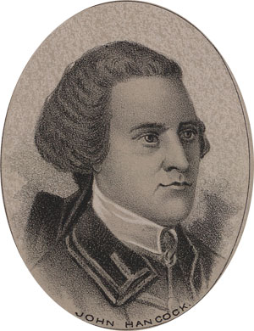
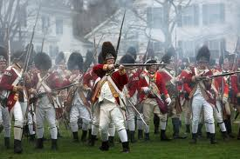
Battles of lexington
battle of lexington
“Shot heard around the world”
Where the American Revolution began with the first shot (heard around the world)
British won this battle
The very first shot in the American Revolution at the Battle of Lexington
No one knows who shot it!
John Hancock

Slide 20
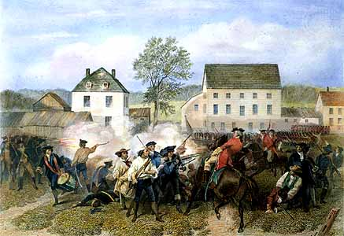
battle of concord
Patriots won this battle because nearby militia joined them
British retreated back to Boston
Women of Concord hid weapons from British

Slide 21
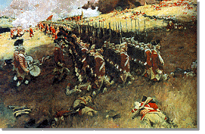
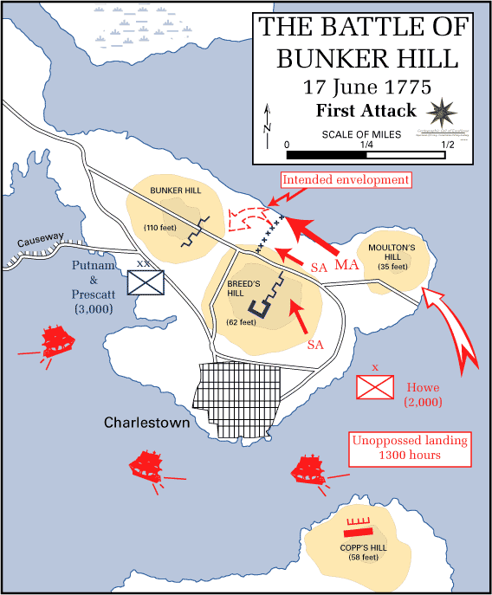
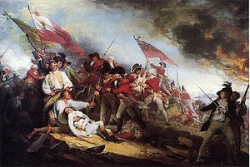
Battle of bunker hill
Colonel Prescott quote: “Don’t fire until you see the whites of their eyes”
Actually fought on Breed’s Hill on Charleston Peninsula
British won this battle… sort of

