Slide 1
Winning the Revolution
CHAPTER 9

Slide 2
Second Continental Congress
Formed Continental Army
Chose George Washington to lead the Continental Army
Met in Philadelphia in May 1775

Slide 3
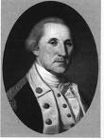
Continental Army George Washington
an army with soldiers from all 13 colonies
leader of the Continental Army

Slide 4
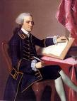
John Hancock
served as president of the 2nd Continental Congress

Slide 5
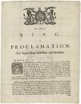
Olive Branch Petition
Written to King George III from Congress
Said the colonists were still loyal to Britain
War could be avoided if British government allowed colonists to self-govern
King didn’t even look at it!

Slide 6
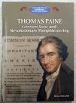
Common Sense Thomas Paine
Written in January 1776
Written in easy language to understand
Convinced people to part from Britian - declare our freedom/
independence
writer
wrote “Common Sense”

Slide 7
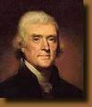
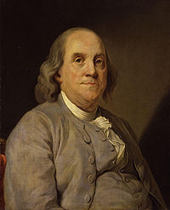
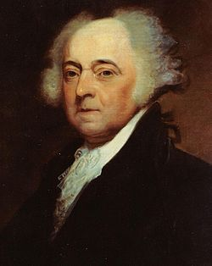
Thomas Jefferson
Lawyer from Virginia
Main author of Declaration of Independence
2 days to draft; 10 days to revise/edit
Benjamin Franklin
Elder statesman
Edited and offered suggestions
John Adams
Suggested Jefferson author Declaration
Argued for it in Congress

Slide 8
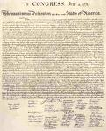
Declaration of Independence
Declared the 13 colonies were independent from Britain
Rights could not be taken away
Life, Liberty, and the Pursuit of Happiness
Officially voted July 4, 1776

Slide 9
traitor
person who works against their country
put to death by hanging

Slide 10
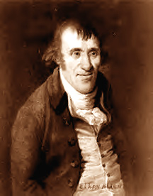
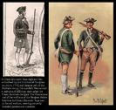
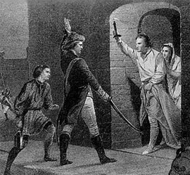
Ethan Allen Green Mountain Boys
Leader of the Green Mountain Boys
Group of Vermont Patriot soldiers who captured Fort Ticonderoga in 1775.

Slide 11
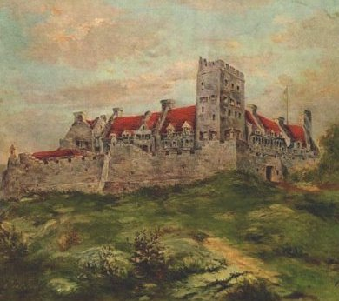
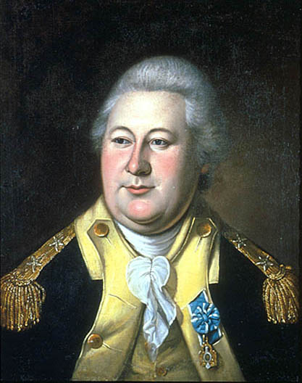
Fort Ticonderoga Henry Knox
May 1775, important early victory
Able to capture British cannons
Continental army leader who brought captured British cannons from Ft. Ticonderoga to Boston in 1775.

Slide 12
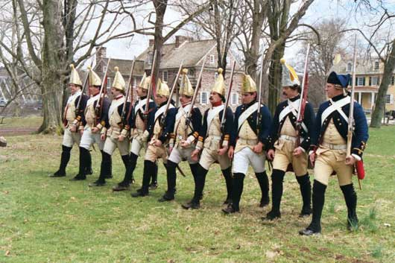
mercenary
soldier from one country paid to fight for another country
Hessians
*mercenaries from Germany
*known for ruthlessness

Slide 13
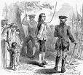
Nathan Hale
teacher who gathered info from behind enemy lines
hanged as a spy by the British in 1776
when asked if he had any regrets, he responded, “My only regret is that I have but one life to give to my country.”

Slide 14
Battle at Trenton
New Jersey
Held by German mercenaries called “Hessians”
Washington attacked Christmas night
Victory gave Americans hope of success

Slide 15
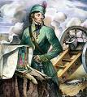
Thaddeus Kosciusko
Polish engineer who designed a fort near Saratoga where Americans won a key victory

Slide 16
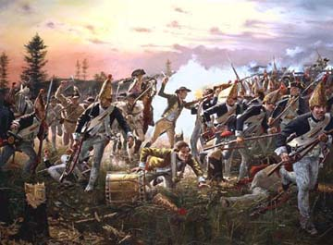
Battle of Saratoga
New York
American victory in 1777
Turning point in the American Revolution
France decided to join the Revolution

Slide 17
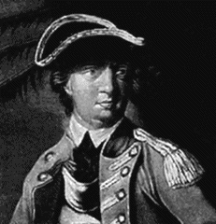
Benedict Arnold
American general who turned traitor in 1780 by joining the British forces

Slide 18
Peter Salem
gained fame at Bunker Hill by standing up to and killing British officer John Pitcairn and at the Battle of Saratoga

Slide 19
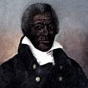
James Armistead
worked as a spy for the colonists by earning the trust of British generals
Earned his freedom for his services after Rev. War ended

Slide 20
Prince Hall
Minister who fought in the Continental army
Early leader in the struggle to end slavery

Slide 21
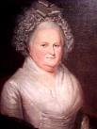
Martha Washington
assisted her husband in Continental Army

Slide 22
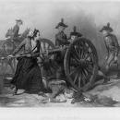
Mary Ludwig Hays
Patriot known for her brave service on the battlefield
known as “Molly Pitcher” for carrying pitchers of water to soldiers on the battlefield

Slide 23
Deborah Sampson
Patriot who disguised herself as a man and served in the Continental Army

Slide 24
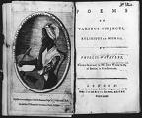
Phillis Wheatley
Published poems supporting the Revolution and opposing slavery
First African American woman to have a book published

Slide 25
Valley Forge
Site SE of Pennsylvania where Washington and Army camped during winter of 1777 & 1778

Slide 26
Friedrich von Steuben
German officer helped turn American soldiers into professional army

Slide 27
Marquis de Lafayette
French soldier who joined Washington staff & became a general in Continental Army

Slide 28
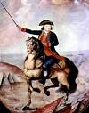
Bernardo de Galvez
Govenor of Spanish Louisianna and ally of Patriots
Led Spanish troops against the British

Slide 29
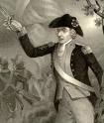
Francis Marion
South Carolina militia leader
nicknamed “Swamp Fox” for his hit-n-run attacks on the British

Slide 30
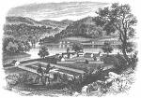
Fort Vincennes
Captured by George Rogers Clark in freezing weather in 1779
This strengthened American control of Ohio River Valley

Slide 31
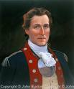
George Rogers Clark John Paul Jones
Leader of small Patriot group
Captured Fort Vincennes in Ohio Valley in 1779
They wouldn’t give up
“I have not yet begun to fight”
He would not surrender
Navy leader who defeated the British ship “Serapis”

Slide 32
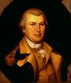
Nathanael Greene Charles Cornwallis
Patriot general during American Revolution
helped Washington defeat Cornwallis at Yorktown
British commander at Yorktown in 1781
was defeated

Slide 33
Battle at Yorktown
Virginia, 1781
George Washington’s Army and the French navy defeated the British
British surrendered to Washington and ended the American Revolution

Slide 34
Treaty of Paris
Treaty signed in 1783 that ended the American Revolution
United States now recognized as an independent country

