Slide 1
Chapter 5
The Struggle to Found Colonies

Slide 2
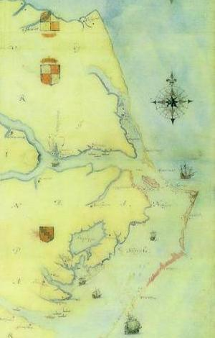
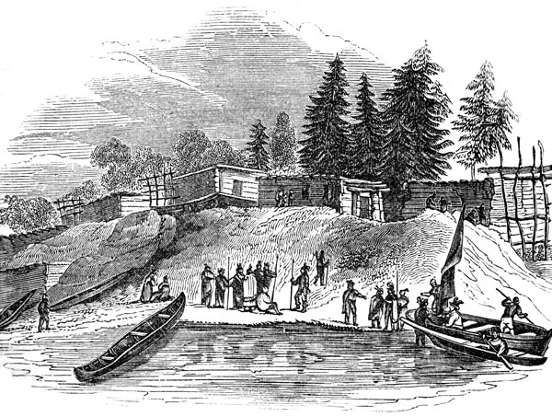
Roanoke Island
England’s first attempt at a colony in America
“Lost colony” – because the settlers disappeared when John White returned from England 3 years later.

Slide 3
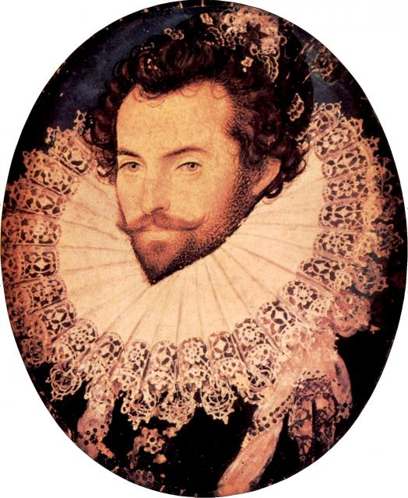
Walter Raleigh
Advisor to Queen Elizabeth I; organized first colony on Roanoke Island – Colonists returned home

Slide 4
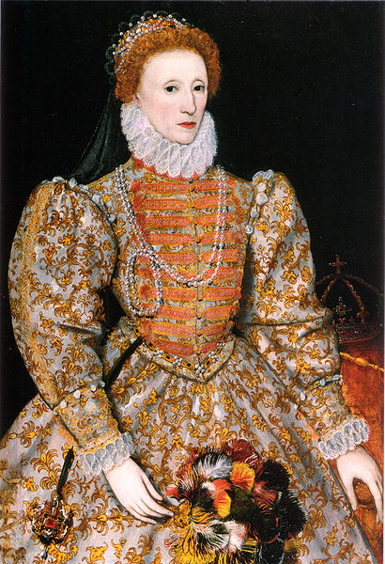
Queen Elizabeth I
*THE “Virgin” Queen of England
*Ruler of England during first attempts to colonize

Slide 5
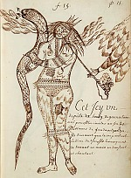
John White
Second to settle Roanoke Island; led 100 men, women and children to America
Supplies ran out, he returned to England to get supplies. When he got back everyone was gone.

Slide 6
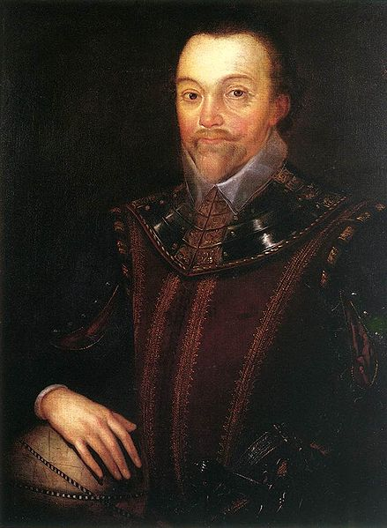
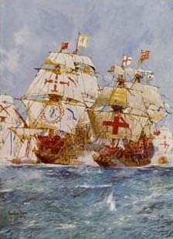
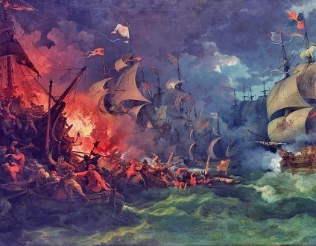
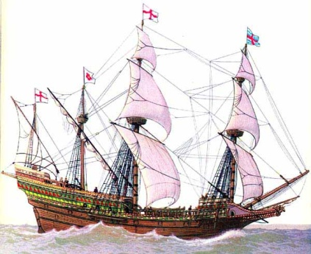
Conflict with Spain
Sir Francis Drake
Spanish Armada v England
Hero? or “Master Thief”?

Slide 7
Charter
A document that permitted colonists to settle on land claimed by their ruler.

Slide 8
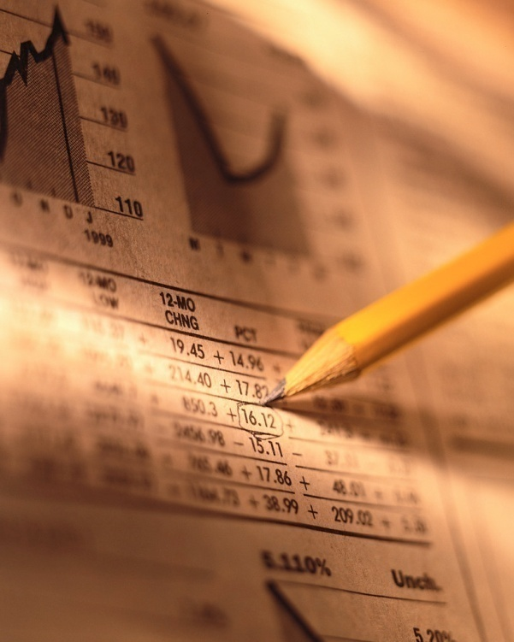
stock
Shares in a company

Slide 9
Virginia
The first colony by England. It was named in honor of Queen Elizabeth

Slide 10
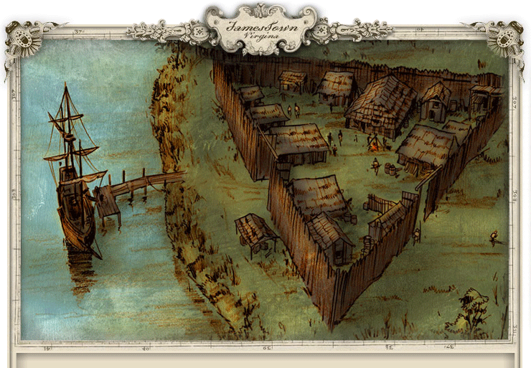
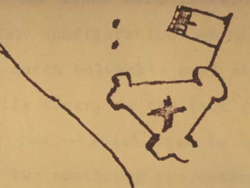
Jamestown
First permanent English settlement on a peninsula of the James River; easy to defend

Slide 11
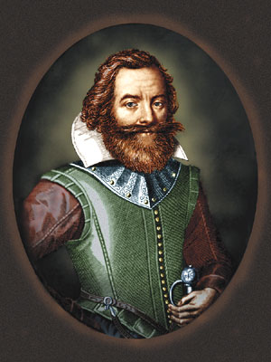
John Smith
One of Jamestown settlers
Thought it would make a great place to settle – Not!! – low, swampy, full of mosquitoes, & the water made people sick!

Slide 12
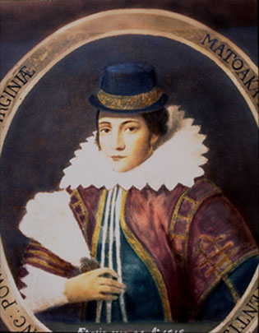
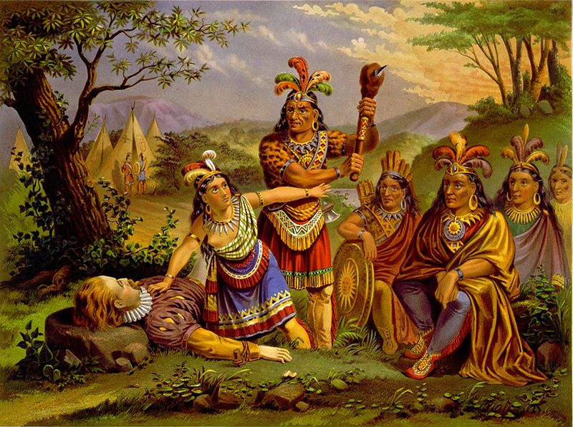
Pocahontas
Saved John Smith from her father. Her father kept the colonists alive.
Later married John Rolfe.
The “Peace of Pocahontas” lasted after her marriage to Rolfe.

Slide 13
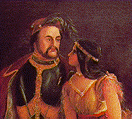
John Rolfe
Saved Jamestown by discovering the potential value of tobacco as a “cash crop”
Married Pocahontas.

Slide 14

Cash crop
Crop grown for profit
Example: tobacco

Slide 15
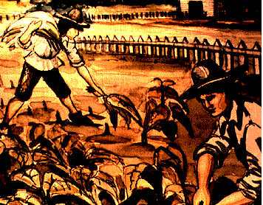
Indentured servants
A person who agreed to work for someone for a certain amount of time in exchange for the cost of an ocean voyage.

Slide 16
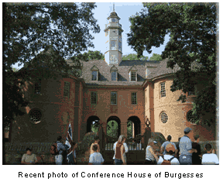
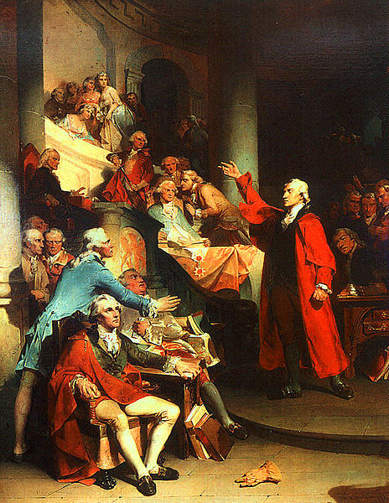
House of Burgesses
July 30, 1619
First lawmaking assembly in the English colony.
Established traditions of self-government in the English colonies.
All members were white, male landowners.

Slide 17
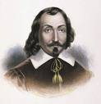
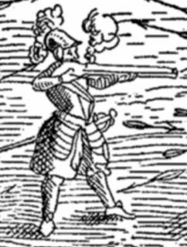
Samuel de Champlain
French explorer
Explored the St. Lawrence River looking for a northwest passage
Champlain
self-portrait

Slide 18
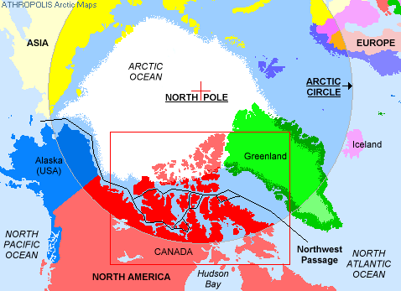

Northwest Passage
A waterway connecting the Atlantic & Pacific Oceans
A practical route does not exist.

Slide 19

St. Lawrence River
Location of French Colony, Quebec.
Quebec was a thriving trade center of beaver fur.

Slide 20
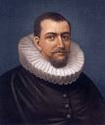
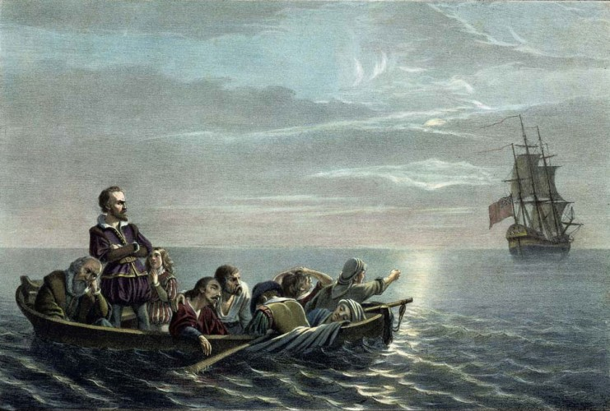
Henry Hudson
Sea captain
Looked for Northwest Passage
Claimed land for Dutch: New Netherlands

Slide 21
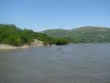
Hudson River
Named after Henry Hudson by the Dutch
Most important settlement located on this river called New Amsterdam (later called New York City)

Slide 22
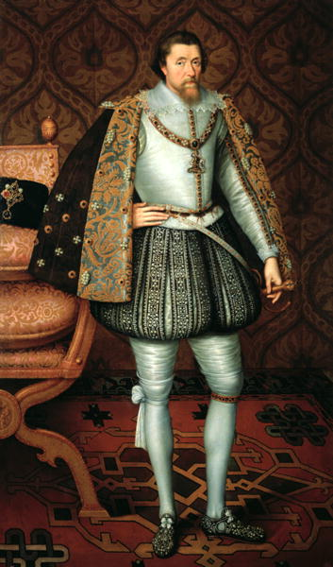
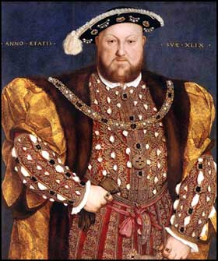
Church of England
King Henry VIII
King James
King of England established the Church of England with the king as its head
Mandated King James version of the Bible. Persecuted Pilgrims

Slide 23
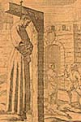
persecution
to treat unfairly because of who you are. Such as being treated unfairly because of your beliefs.

Slide 24
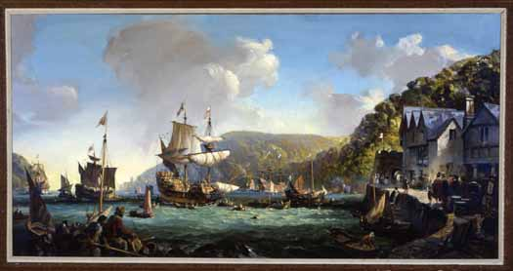
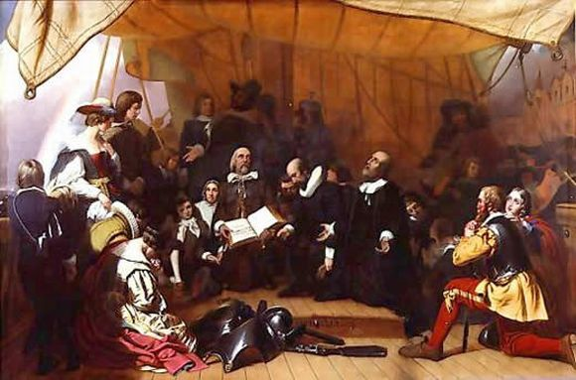
Pilgrim (Separatist)
pilgrim- anyone who travels for religious reasons
Separatist- a group who felt the Church of England was so corrupt that they should “separate” from it. Also known as “The Pilgrims”

Slide 25
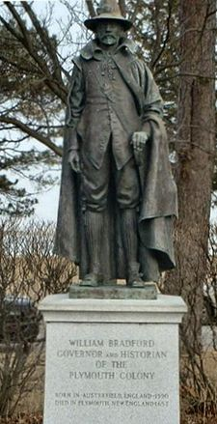
William Bradford
leader of the Pilgrims

Slide 26
New England
Massachusetts
Plymouth

Slide 27
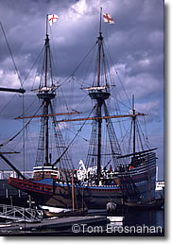
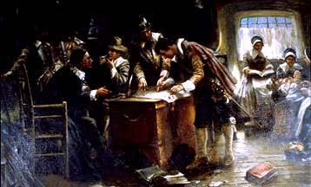
Mayflower Compact
A document establishing self-government signed by all men aboard The Mayflower before going ashore

Slide 28
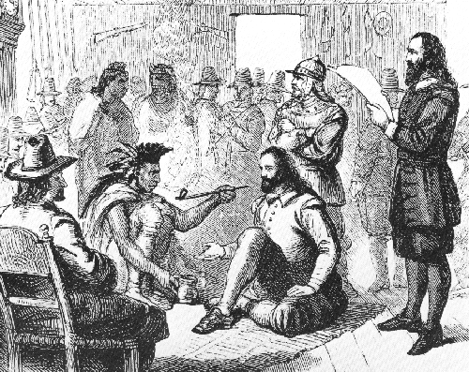
Thanksgiving
Samoset- first Native American to make contact with Pilgrims.
“Welcome Englishmen”
Massasoit- the Chief of the local tribe
Squanto- came to live with the Pilgrims, teaching them to survive by planting/hunting/
trapping

Slide 29

Puritans
Wanted to reform the Church of England
They were persecuted and put in jail for their beliefs
Puritans created the first public school

Slide 30
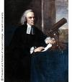
John Winthrop
Led the puritans so they could worship as they pleased
Built their own colony-Massachusetts Bay Colony (well prepared)

Slide 31

Massachusetts Bay Colony
Puritan colony
Fishing, fur trading & ship building made their economy do well
Main settlement was Boston

Slide 32
Pilgrims vs. Puritans
Pilgrims
Puritans
Had Thanksgiving with the Indians (Wamponaog)
Led by William Bradford
Trained kids to help defend fort
Separated from the Church of England
Sailed on the Mayflower across the Atlantic ocean; half died within first winter
Landed in Cape Cod which had swampy land and mosquitos
Squanto helped the Pilgrims plant crops, fish, work the land, & translated (helped them to survive)
Before unloading the Mayflower, men signed the Mayflower Compact (first sign of democracy)
Settled in Boston area; Massachusetts Bay colony
Started first public school
Sent people to prepare colony land & buildings
More prepared
1000 people came across the Atlantic Ocean on 15 ships
Led by John Winthrop
Used pillory & stocks to punish those who broke laws
Wanted to purify (or make simpler) the Church of England
Ministers served as the judges

Slide 33
Both Pilgrims & Puritans
Had cannons and sharp tipped fences
Started colony for religious freedoms
Came from England & were part of Church of England – wanted change
Hunted, traded, farmed and fished for survival/economics of colony
Established colonies in New England area
Crossed Atlantic Ocean to get to American colonies
Had meeting hall where religious services were held

Slide 34
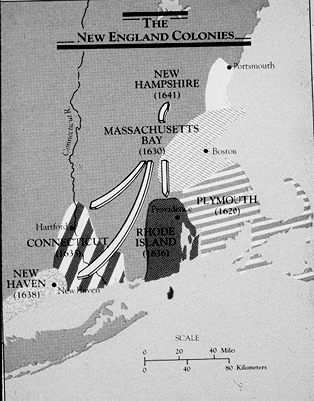
New England Colonies
Massachusetts
New Hampshire
Rhode Island
Connecticut
Mom
Never
Runs
Cross country
Thin rocky soil made it difficult for large scale farming
Natural resources included fishing and timber which led to shipbuilding

Slide 35
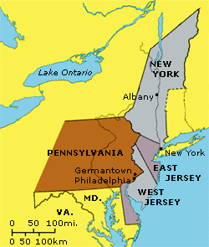
Middle Colonies
New Jersey
New York
Pennsylvania
Delaware
New
York
Police
Department
The fertile soil and climate made for excellent farming of grains, especially wheat. So much wheat was produced and milled here the Middle Colonies became known as the “Breadbasket” of the colonies

Slide 36
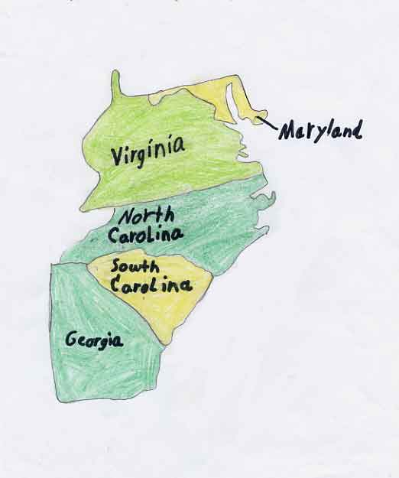
Southern Colonies
North Carolina
South Carolina
Maryland
Virginia
Georgia
Never
Sell
My
Viper
Girlfriend
Its warm climate and fertile soil made the Southern colonies an excellent region for producing cash crops such as tobacco, rice, and indigo

Slide 37

dissenter
A person whose views differ from those held by most people in the community.

Slide 38
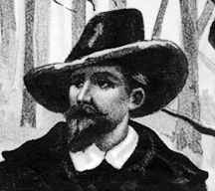
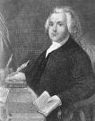
Roger Williams
Outspoken minister in Salem, Massachusetts
Believed government should not punish citizens for what they believe
Established colony of Rhode Island with first settlement: Providence
True freedom of religion

Slide 39

Anne Hutchinson
A dissenter
Believed people should not have to go through a minister, but could pray directly to God from anywhere
Forced to leave Massachusetts and moved to Rhode Island

Slide 40
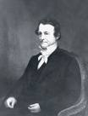
Thomas Hooker
Puritan minister who founded Connecticut & was seeking political & religious freedom

Slide 41
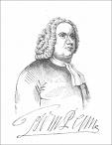

William Penn
Quaker who was given land by King Charles II
Established colony of Pennsylvania settlement of Philadelphia
Pennsylvania= Penn’s Woods
Philadelphia = City of Brotherly Love

Slide 42
Proprietors
An owner

Slide 43

James Oglethorpe
English leader started colony for debtors – start new lives & own land
New colony – Georgia settlement – Savannah
Georgia helped protect English colonies from Spanish settlements

Slide 44
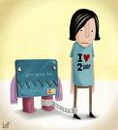
debtors
People who owed money

Slide 45

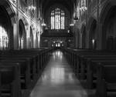
Quaker vs. Catholic
Quaker
Catholic
Opposed war and believed that people could worship God without going to church or following religious laws
Seeking religious freedom because they faced persecution in England; settled in Maryland

Slide 46
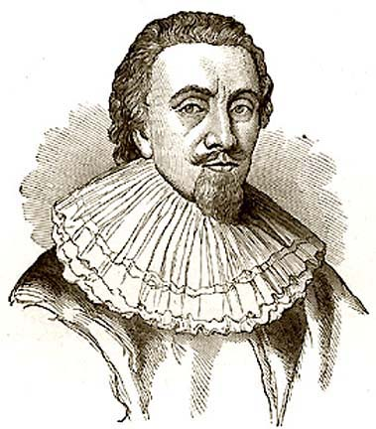

Lord Baltimore
Sought religious freedom for Catholics
Colony of Maryland, settlement of Baltimore

