Slide 1
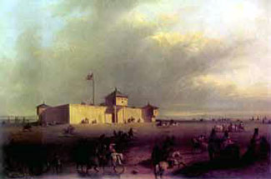
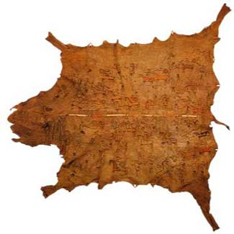
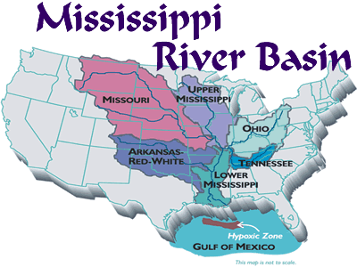
The French Explore the Mississippi
Trading post: places established where settlers and trappers could trade with Native Americans

Slide 2
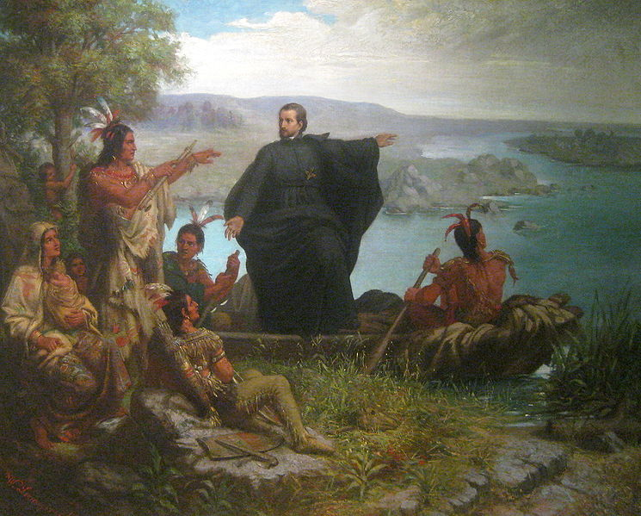
Exploring the Mississippi
Jacques Marquette: explored and mapped the Mississippi in search of Northwest Passage
Louis Jolliet: accompanied Marquette

Slide 3
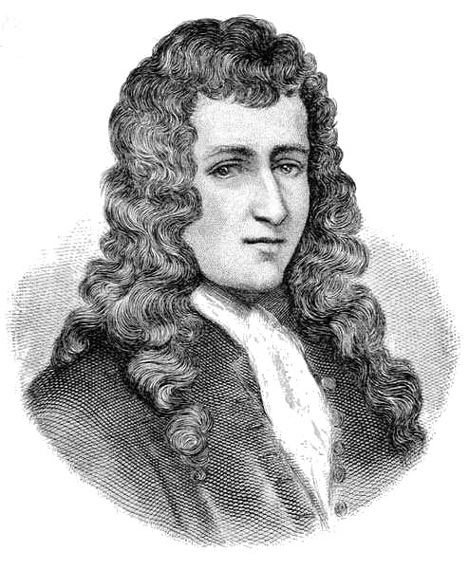
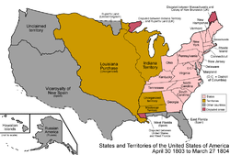
Founding Louisiana
Robert La Salle: French explorer who traveled to the mouth of the Mississippi River and claimed the entire Mississippi River Valley for France
Louisiana Territory

Slide 4
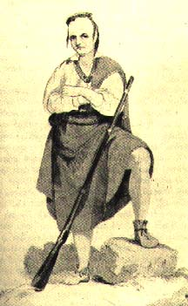
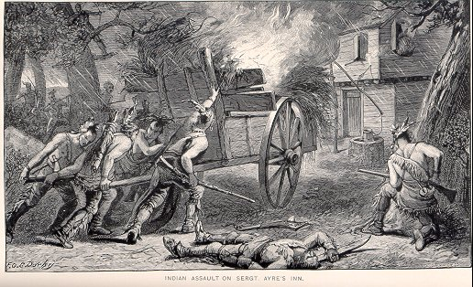
Conflicts Over Land
Metacom: known as “King Philip” by the English. Led revolt known as “King Philip’s War”; son of Chief Massasoit
backcountry: the land between the Atlantic coastal plain and the Appalachian Mountains

Slide 5
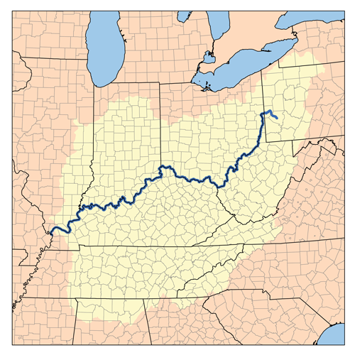
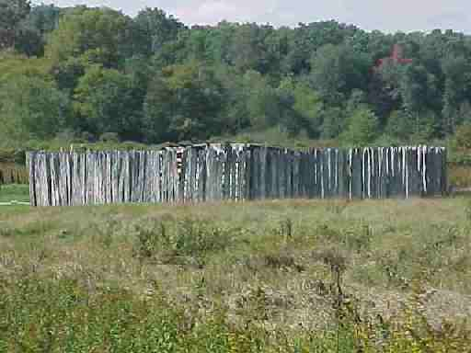
French and Indian War
Ohio River Valley: rich land along the Ohio River which was disputed by France and Great Britain
Fort Necessity: a hastily built fort in preparation for conflict with the French

Slide 6
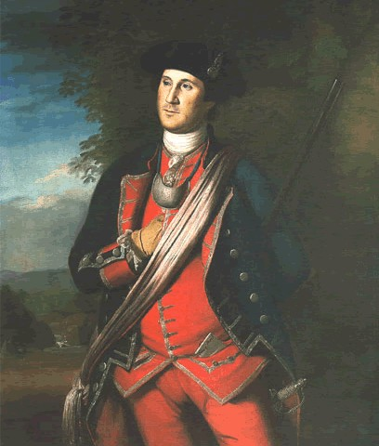
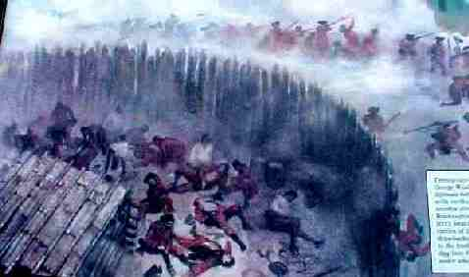
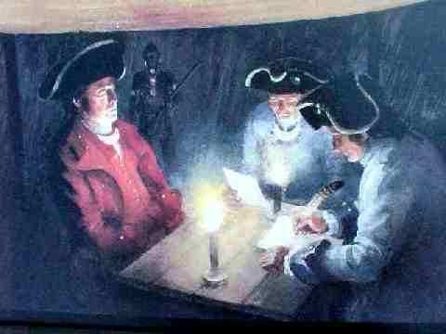
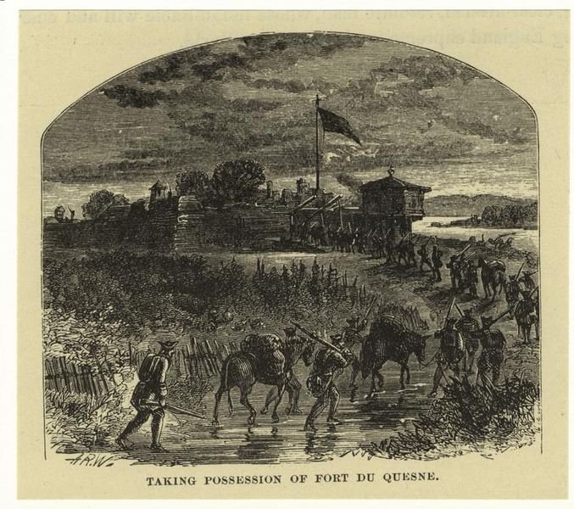
The Ohio River Valley and Conflict
George Washington from time of French and Indian War;
Battle at Fort Necessity
Fort Duquesne
Washington signing surrender papers

Slide 7
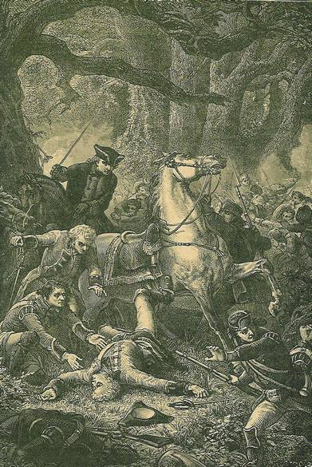
The French and Indian War begins
General Edward Braddock’s death

Slide 8
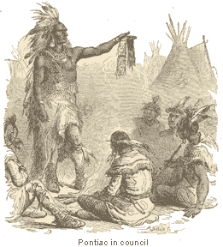
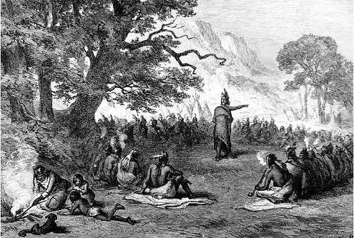
British Victory…gained large amounts of Land and large debt
Pontiac’s Rebellion: final attempt to drive out English from Ohio River Valley

Slide 9
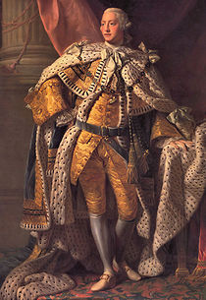
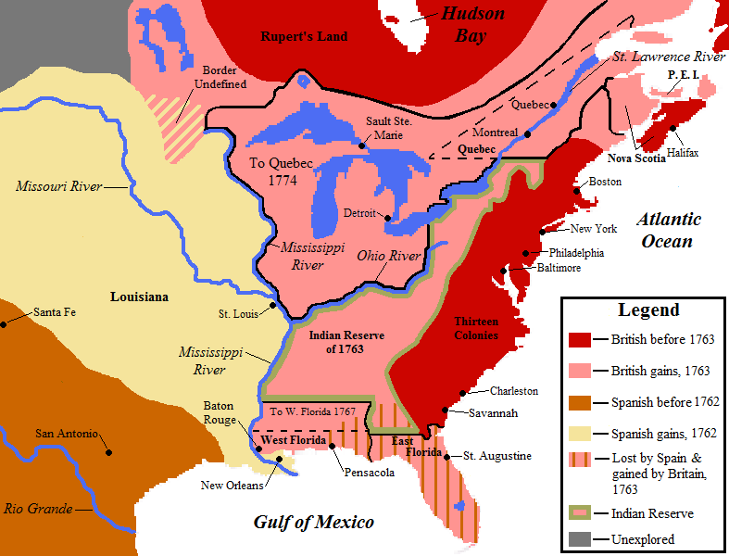
The outcome of war
map showing British land gains after war
King George III: issued Proclamation of 1763 forbidding settlement beyond Appalachian Mts

