Slide 1

Overview Unit
Social Studies

Slide 2

“E Pluribus Unum”
Latin for “out of many, one” – many people came together to form one country
Because of the many varieties of people coming together
Out of many states, one country was formed

Slide 3

Culture
The way of life of a group of people
Includes religion, customs, and language

Slide 4
Ideals
Important beliefs
Include freedom of speech, freedom of religion, and freedom to live and work where we choose
Equal rights and fairness for all people

Slide 5

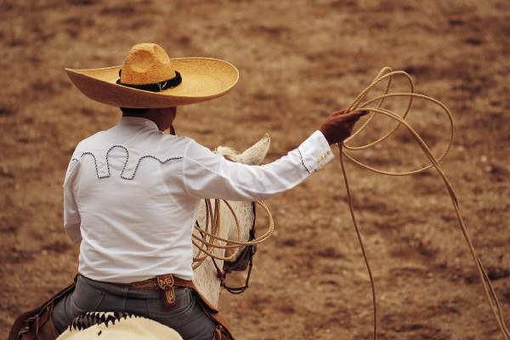

Ethnic group
Group of people who share the same customs and language
Example: Americans whose families originally came from Spanish-speaking Latin American countries are part of an ethnic group called Hispanics

Slide 6

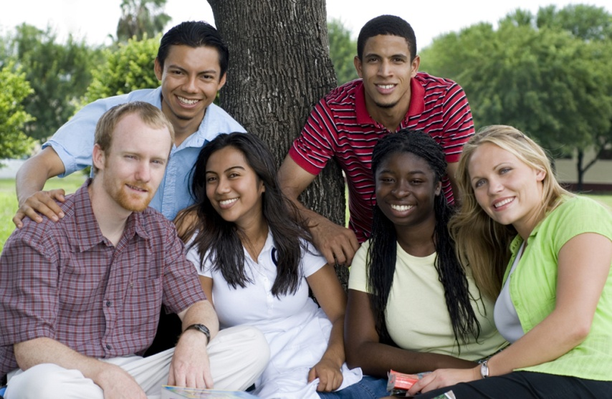
Immigrants
People who leave one country to go live in another country.
People who come to live in the USA from all over the world
Come to the land of opportunity and liberty

Slide 7


The Pledge of Allegiance
I pledge allegiance to the Flag of the United States of America and to the Republic for which it stands, one Nation under God, indivisible with liberty and justice for all.

Slide 8
Democracy
People have the power to make decisions about government (government is run by the people)
Example: Ability to vote on decisions made

Slide 9
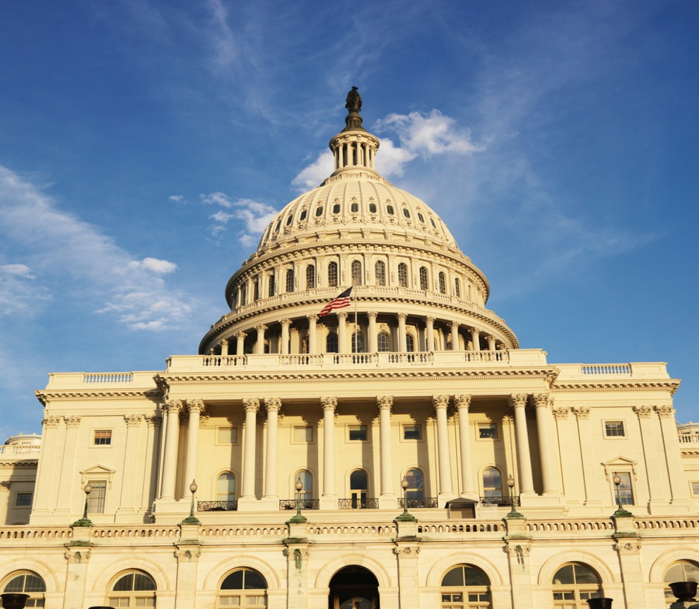
Republic
People elect representatives to make laws and run the government
Remember: republic – represent

Slide 10

constitution
constitution (lower case c) is any written form of government
Constitution (upper case c) is our United States written plan of government

Slide 11
Citizen
Member of a country
**Responsibilities: serve, stay informed, vote

Slide 12
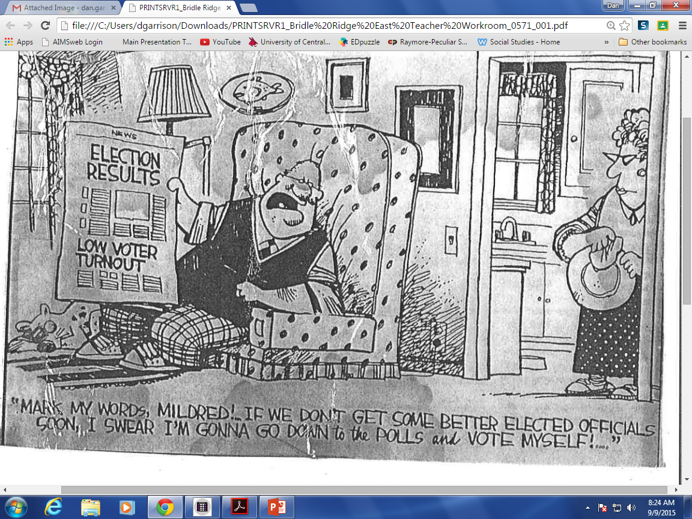

Slide 13
John F. Kennedy
“And so, my fellow Americans – ask not what your country can do for you – ask what you can do for your country.”
He was calling on Americans to meet the responsibilities we all share. The U.S. belongs to the people, so it is up to the people to make the country work.

Slide 14
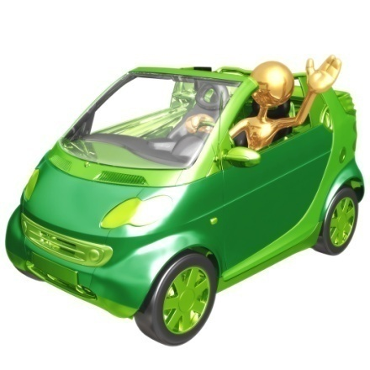
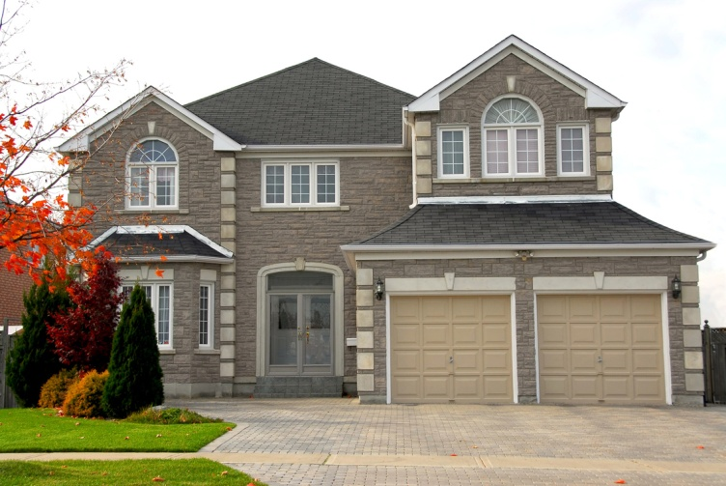
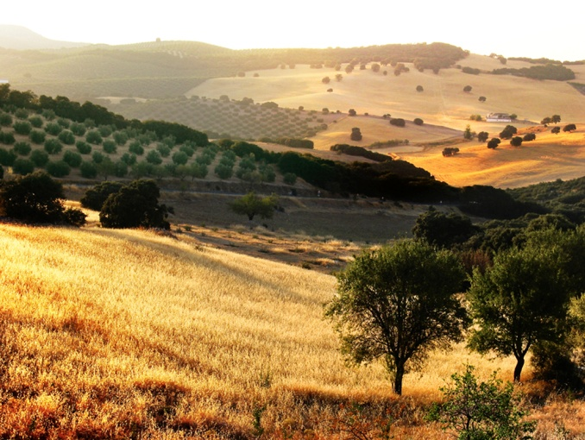
Private Property
Something (land, house, or car) owned by individual people or groups

Slide 15
Economy
A system for producing and distributing goods and services

Slide 16
Free Enterprise
People are free to start their own businesses and own their own property
They have a choice of products, spending, starting a new business, etc.

Slide 17

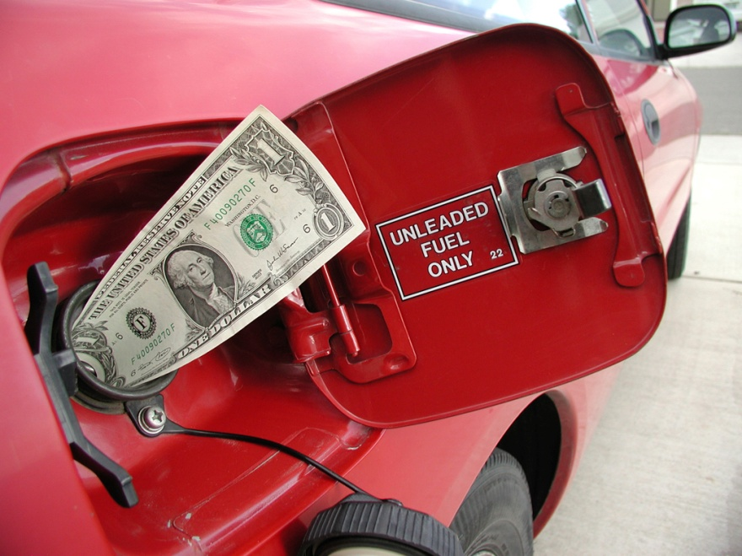
Profit
The money a business has left after it has paid all costs

Slide 18


Supply Demand
The amount of a product that is available
The amount of a product that people are willing to buy.

Slide 19
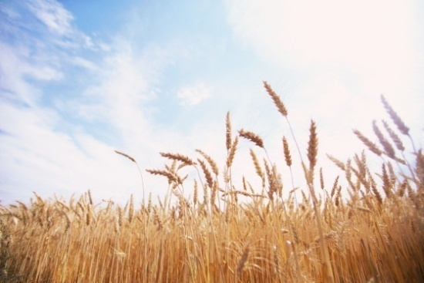
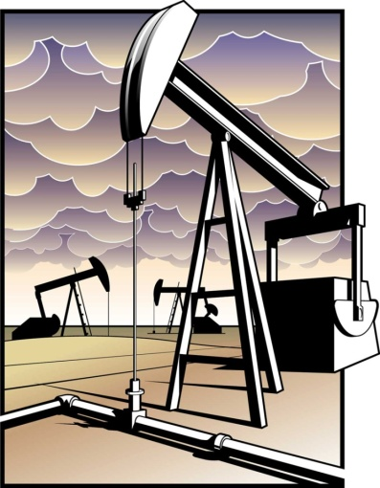
Export Import
A good that one country sells to another country
U.S. is the world’s leading exporter of wheat and corn.
A good that one country buys from another country.
The U.S. imports oil from Mexico, Saudi Arabia, and other countries.

Slide 20

Consumer
A person who buys or uses goods and services.
Consumers can choose between a great many products. Consumers can make choices about how to spend their money.

Slide 21

Entrepreneur
A person who starts a new business, hoping to make a profit.

Slide 22
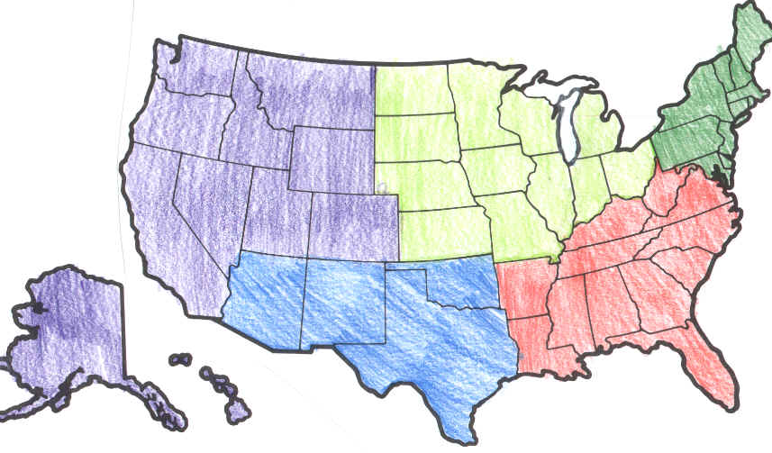
Region
A large area that has common features that set it apart from other areas.
Makes it easier to study our country’s geography.
The U.S. is divided into 5 regions: The Northeast, Southeast, Midwest, Southwest, and West.

Slide 23

Geography
The study of Earth and how people use it.

Slide 24
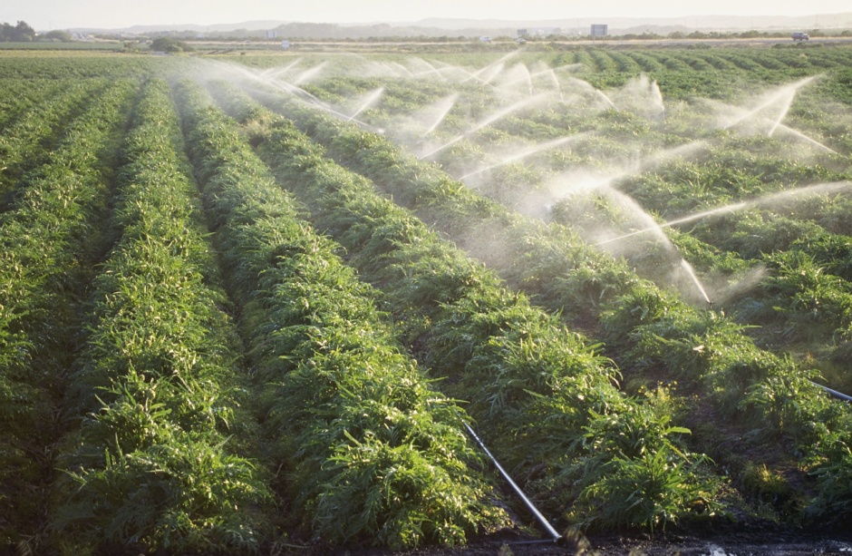
Agriculture Irrigation
The business of growing crops and raising animals (one of the most important uses of land).
A method of bringing water to dry land.

Slide 25
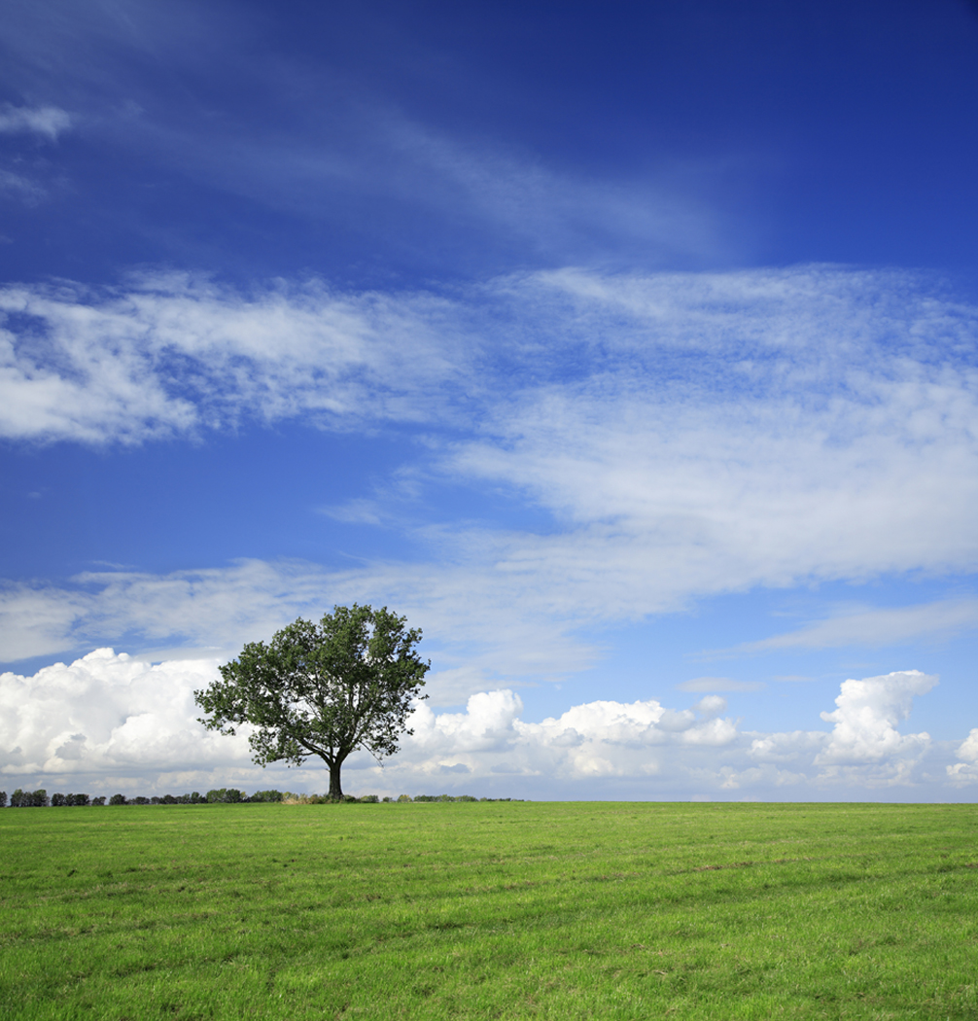
Climate
The weather in an area over a long period of time

Slide 26
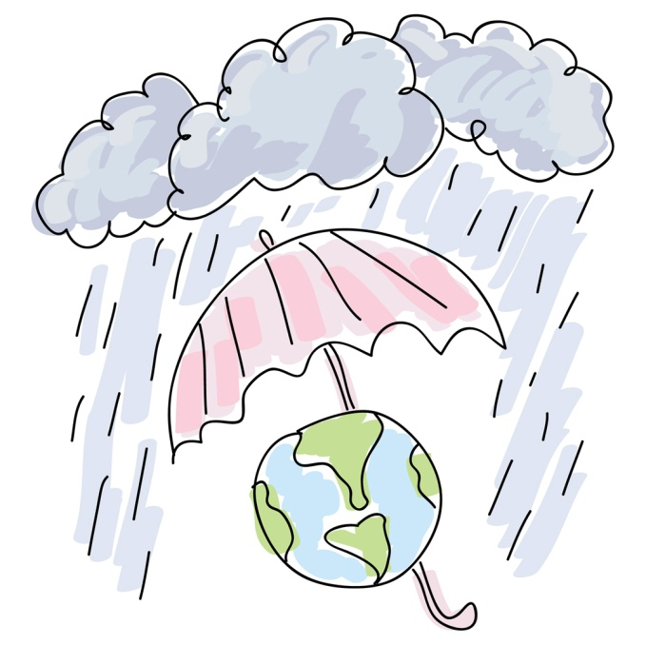
Precipitation
The moisture that falls to the Earth in the form of rain, sleet, or snow.

Slide 27

Interdependent
How different regions need each other

Slide 28
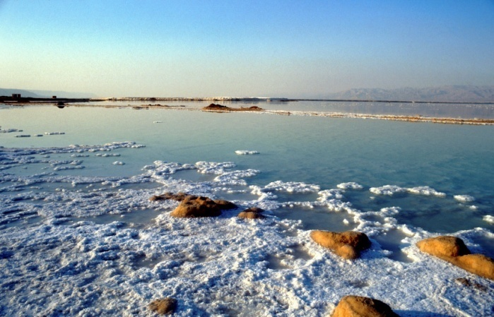
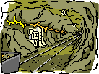
Minerals
Substances found on Earth that are neither animal nor vegetable (considered a natural resource).
Useful metals such as gold, copper, and aluminum are minerals. So are non-metals like salt and granite.

Slide 29
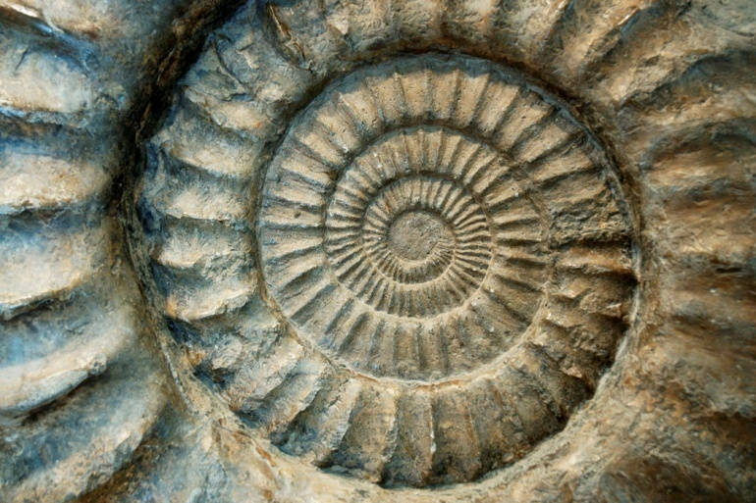
Fossil fuels
A key type of mineral resources
Fuels formed from the remains of plants and animals that lived thousands of years ago.
Coal, oil, and natural gas are examples of fossil fuels.

Slide 30
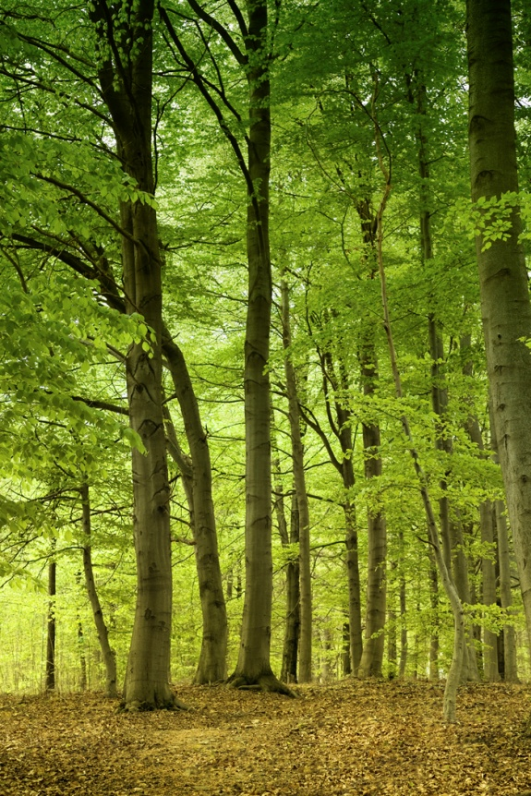
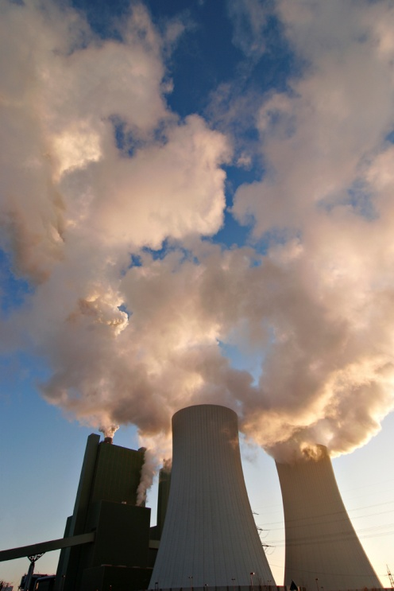
Renewable Nonrenewable
Resources Resources
Resources that can be replaced or renewed
Example: trees
Resources that cannot easily be replaced
Example: fossil fuels

Slide 31
Conservation
Preserving and protecting resources – we need to make sure there will be enough resources in the future!

Slide 32
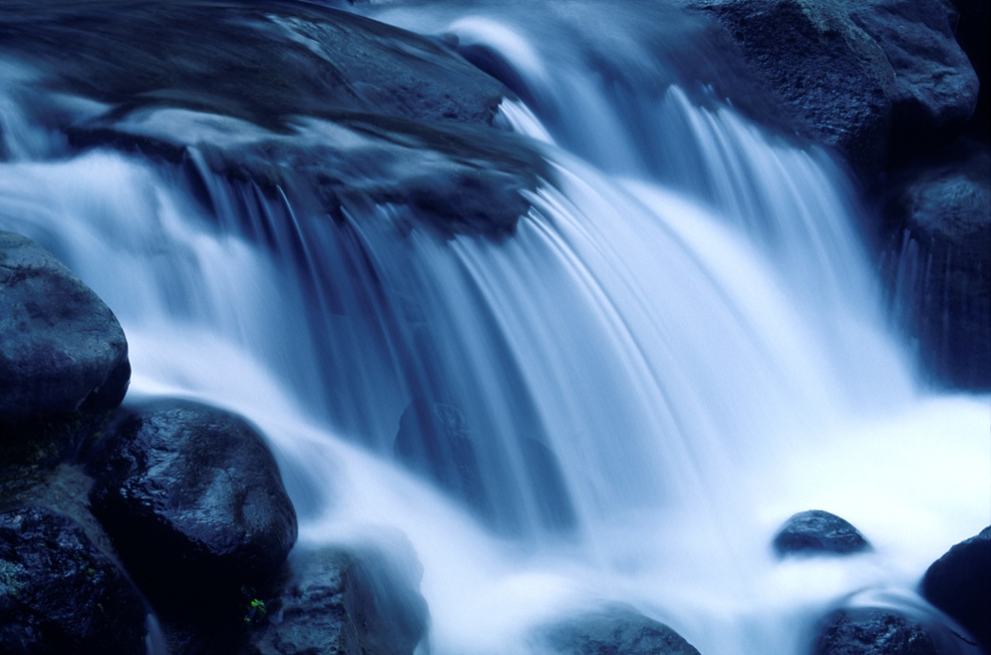
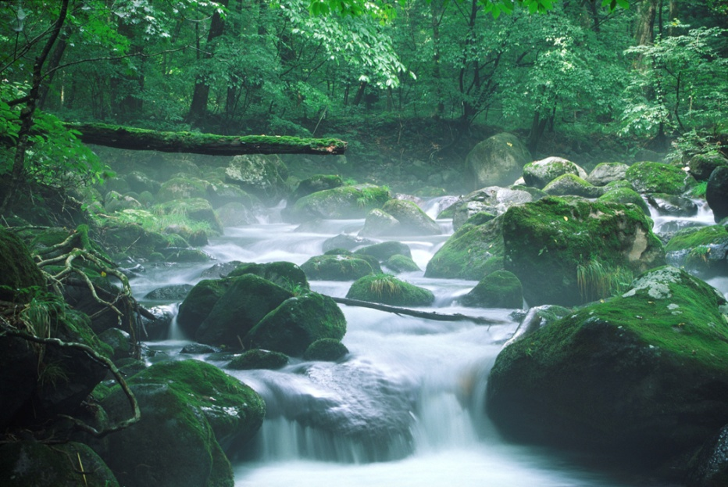
Environment
Made up of all the things that surround us, such as land, water, air, and trees.

Slide 33
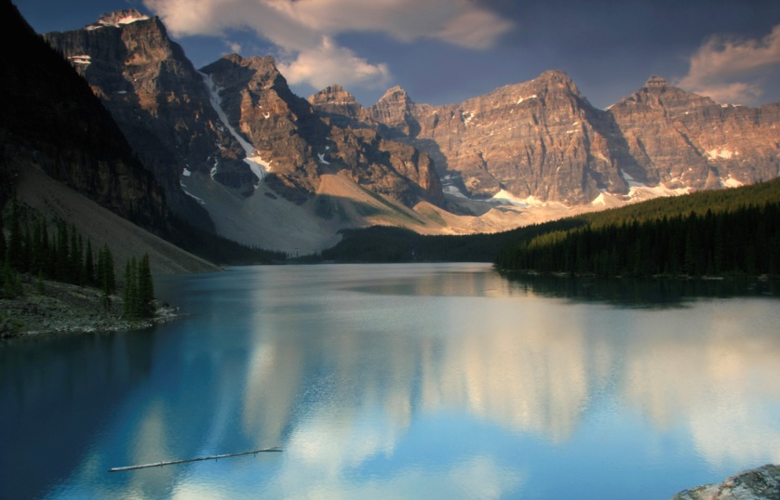
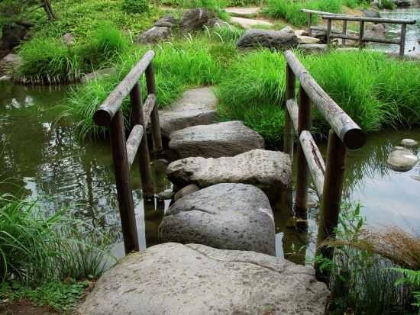
National Parks
Creating parks is one way to help protect the environment (preserve the land, plants, animals, and other natural resources). They are protected by the federal government.
First park – Yellowstone National Park, 1872
Parks are for the “benefit and enjoyment of the people.”

Slide 34
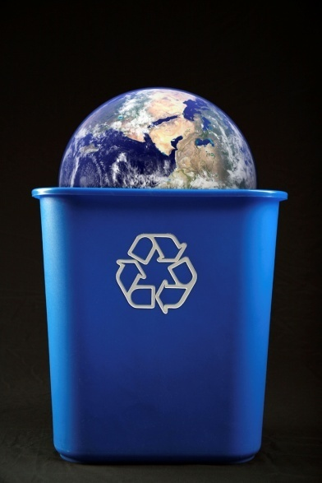
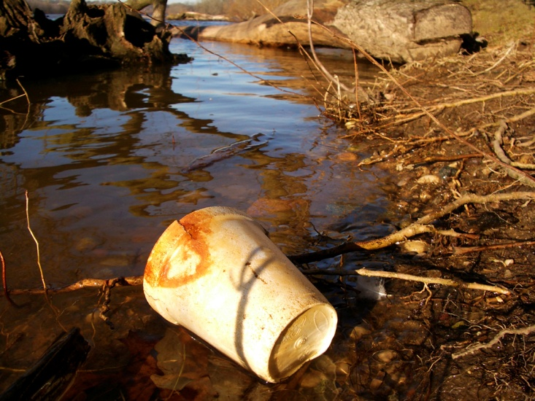
Pollution
Pollution is the addition of harmful substances to the air, water, or soil.
It is a common environmental problem . Air pollution is a problem is large cities.
Recycling (using something again) is something that each person can do to help.

