Slide 1
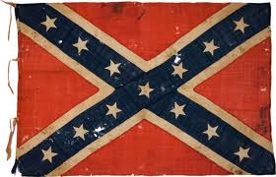
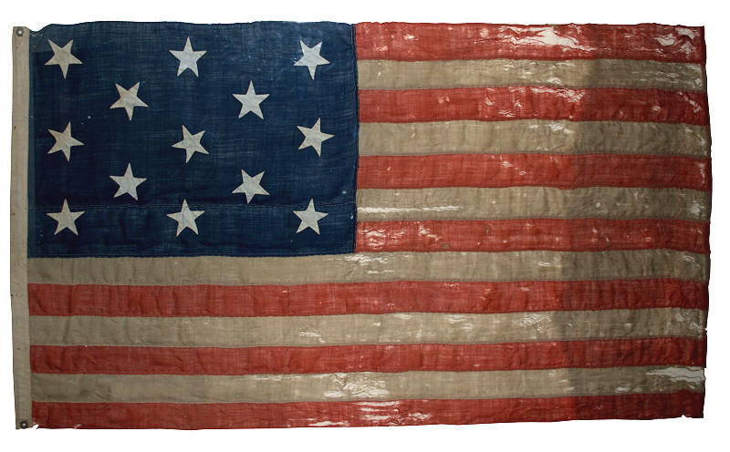
War and Reconstruction

Slide 2
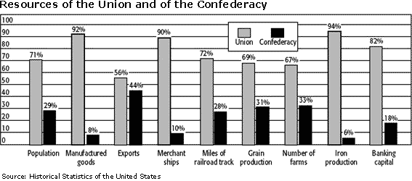
Advantages and Disadvantages
Although it would appear at first glance that the North had all the advantages, the South had certain elements to their advantage:
most of the highly trained military officers were Southern
most Southerners were familiar with aspects of rural life (horses, camping, hunting)
familiarity with the land
saw themselves fighting to preserve their way of life (culture)

Slide 3
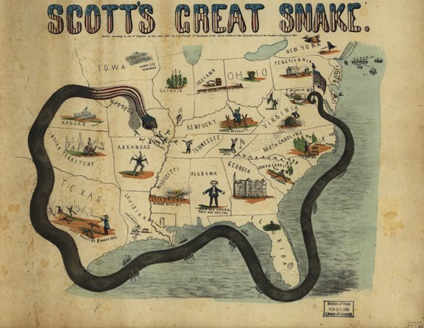
Strategy
Blockade to prevent
Southern trade
Control the
Mississippi and divide
Confederacy
Attack from East and West

Slide 4
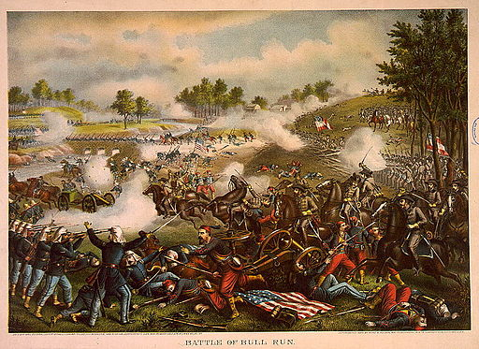
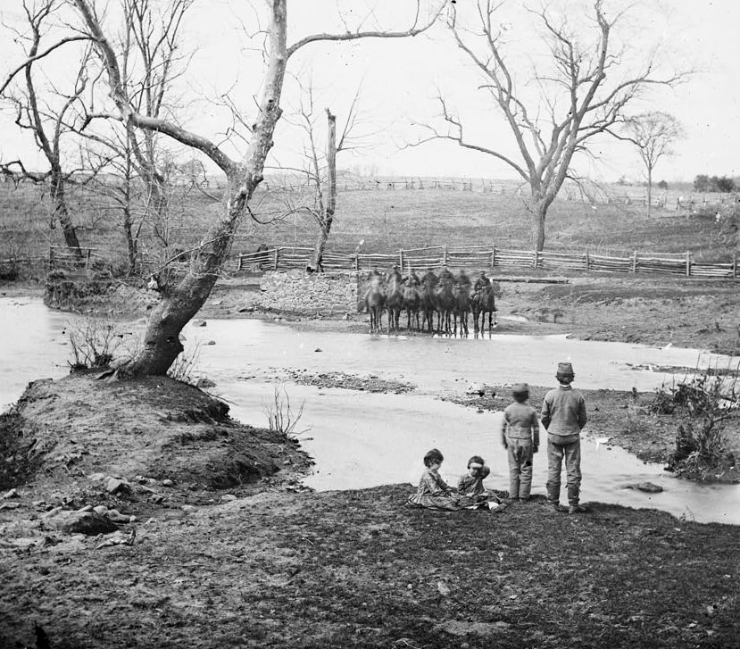
Manassas/Bull Run
Bull Run illustrated the miscalculation on both sides concerning their opponents. The North was so certain of victory, people came out with picnics to watch the Rebellion put down. But the South, although outnumbered, showed military superiority and reversed the battle to their victory. The result was Northern troops fleeing back toward Washington and the South growing more confident in their ability.

Slide 5
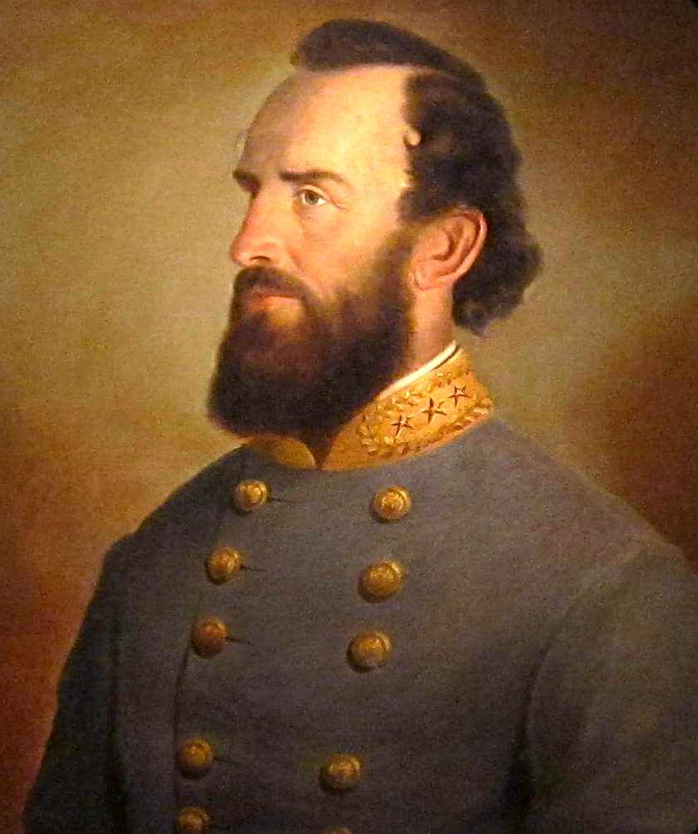
Thomas “Stonewall” Jackson
earned his name by refusing to budge during the Battle of Bull Run. His resolute manner encouraged his men and began to turn the battle to their favor. It was he that suggested pursuing the fleeing Union troops and attacking Washington D.C.
He was overruled by Jefferson Davis.

Slide 6
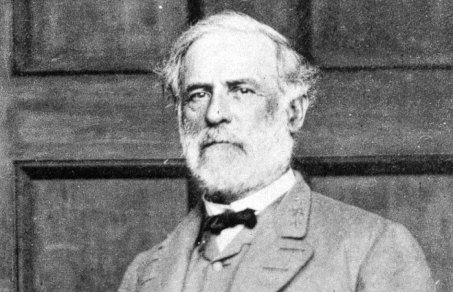
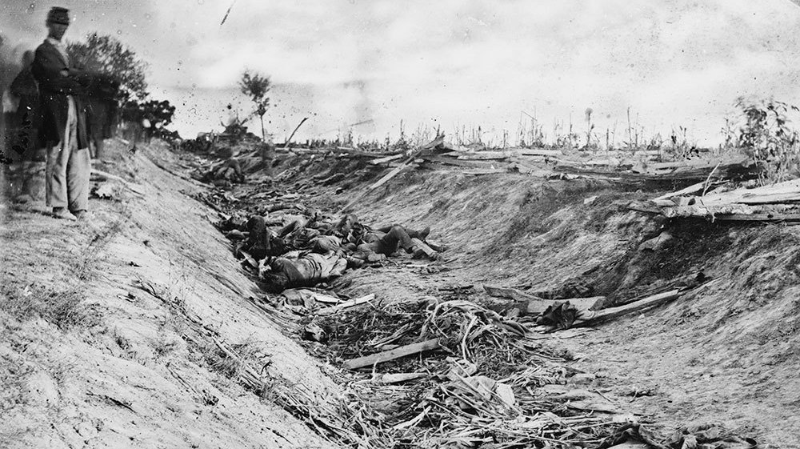
Antietam
After the Union victory, the
possibility of Britain aiding the
Confederacy was gone.
Robert E. Lee had originally been
sought to lead the Union, but although
he opposed slavery and secession, he
could not bring himself to fight against
the South.

Slide 7
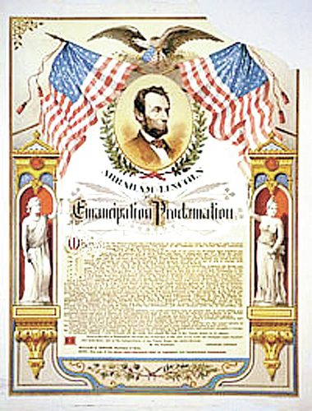
The Emancipation Proclamation was an extremely risky, extremely daring, and most assuredly an act of bravery on the part of Lincoln. After the win with Antietam, Lincoln felt he had leverage to enact this daring piece of executive power. In it, he freed all slaves within the states of rebellion. Although Lincoln was moved to eliminate slavery completely, he avoided freeing slaves in the border states for fear of prompting those states to secede.

Slide 8
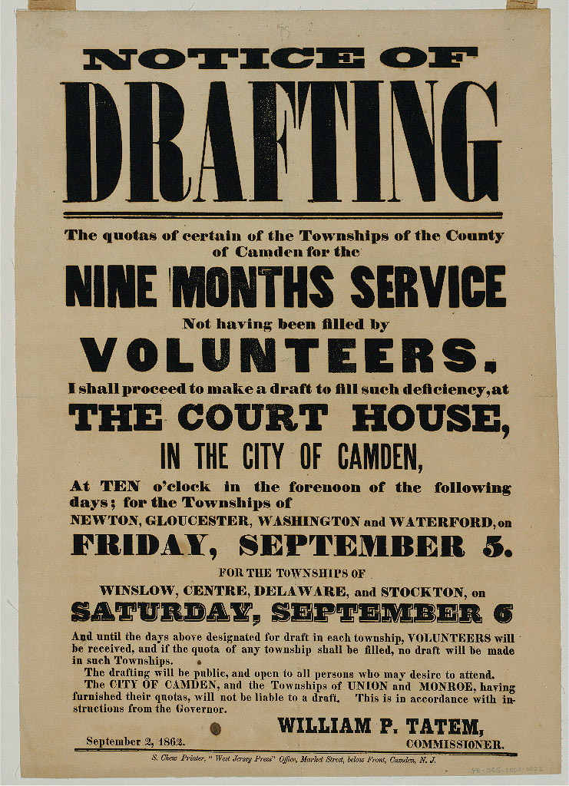
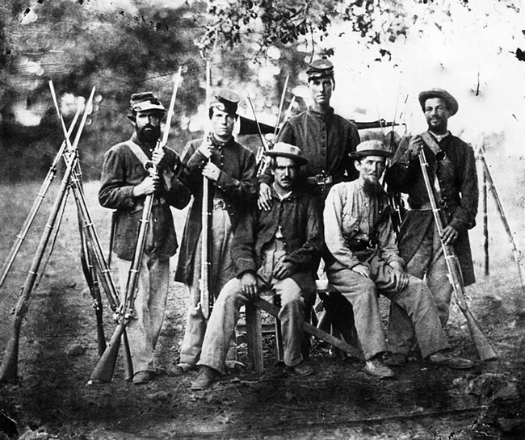
Conscription enacted.
As the war dragged on, there were not enough volunteers joining the military.
For the first time, both sides
passed draft laws. This meant
that men of a certain age
were required to join the
service.

Slide 9
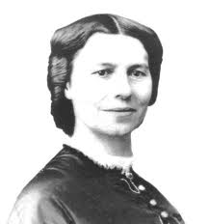
Women helped in many ways.
Most notable were the women who
served as nurses. Clara Barton had
no medical training, but recognized
the need for things such as clean
bandages and triaging patients.
She went on to found the American
Red Cross.

Slide 10
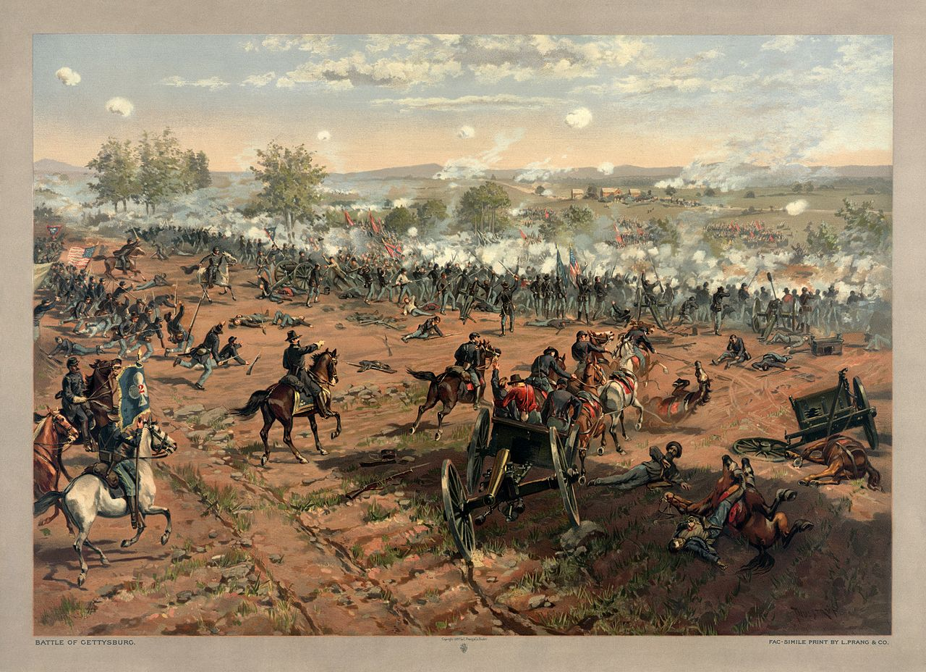
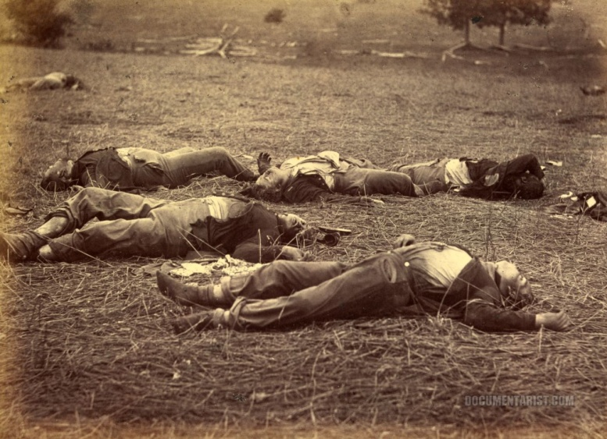
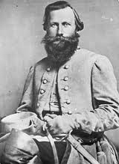
Gettysburg
Gettysburg was a three day
campaign into the North.
Although the Confederate Army initially had the advantage, as more
Union troops arrived the battle turned in favor of the North. More than 50,000 died during this
Battle.
Jeb Stuart, the Confederate cavalry leader, was late arriving. Lee considered Stuart’s cavalry his “eyes” and was put at a disadvantage without his presence.

Slide 11
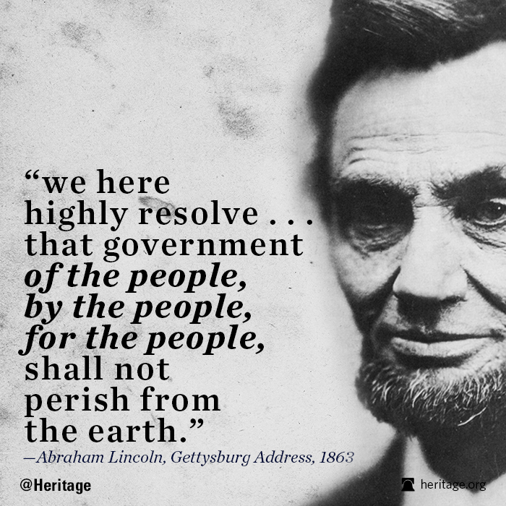
Perhaps the nation’s finest piece of political oratory, Lincoln’s
observation about the nation’s ideals and principles became one of
America’s sacred documents. Lincoln eloquently delivered this short speech at the consecration of the Gettysburg battlefield as a national cemetery.

Slide 12
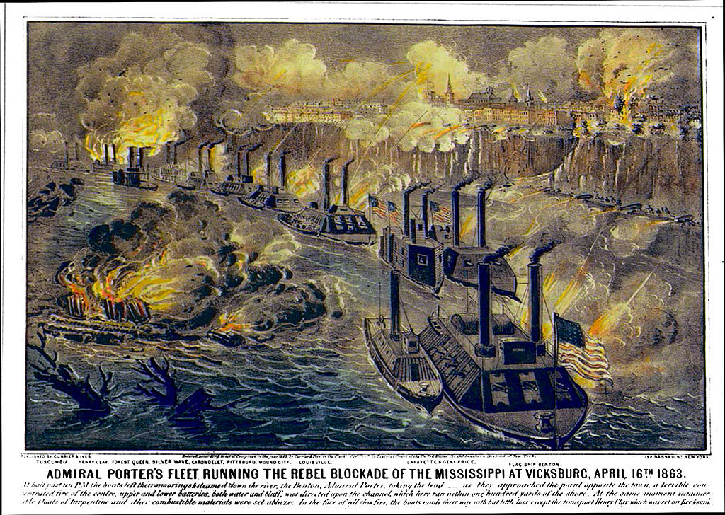
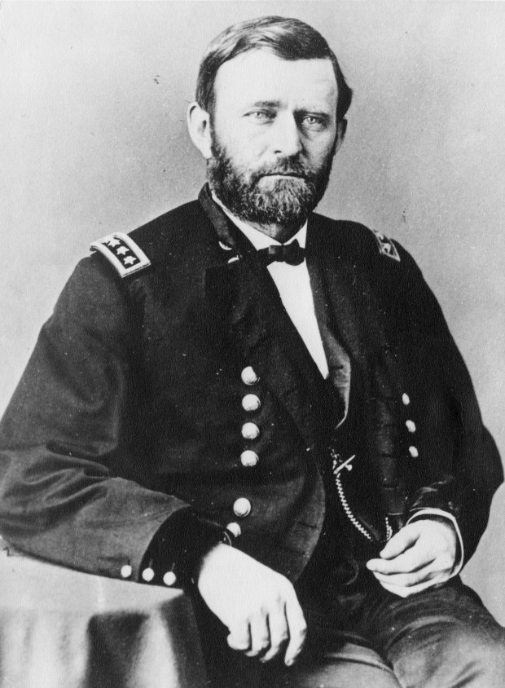
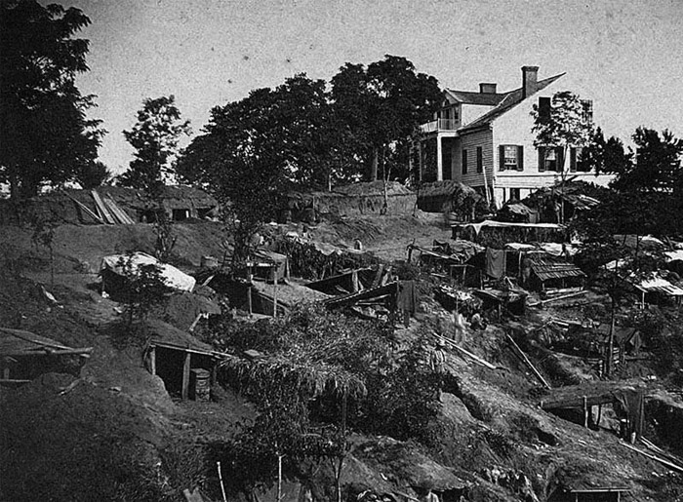
The tide turns…
Vicksburg
Lincoln finally finds his general, Ulysses S. Grant. Grant blockaded the city of Vicksburg as part of the Anaconda Plan. The city was under siege and finally succumbed to Union forces, giving the Union control of the Mississippi.

Slide 13
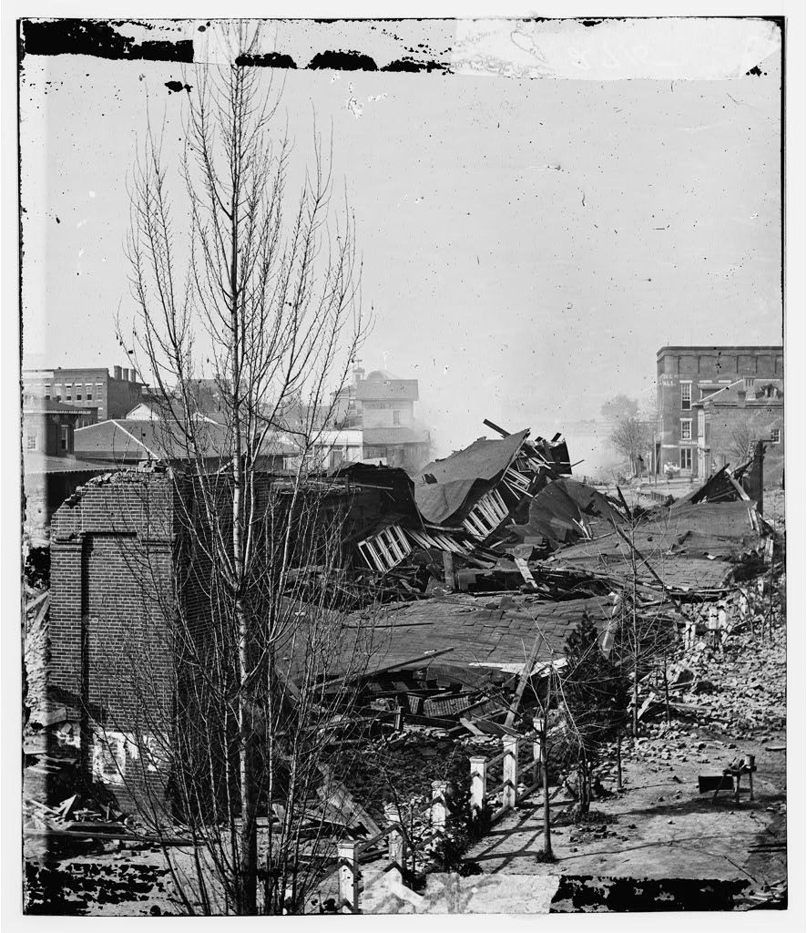
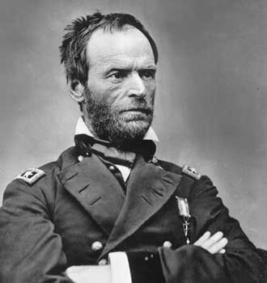
Grant waged a total war on the South. This means he used whatever means
was necessary to win battles, including destroying anything the South might
use as a resource.
William Tecumseh Sherman led the “March to the Sea” leaving a path of destruction in his wake.

Slide 14
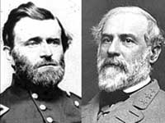
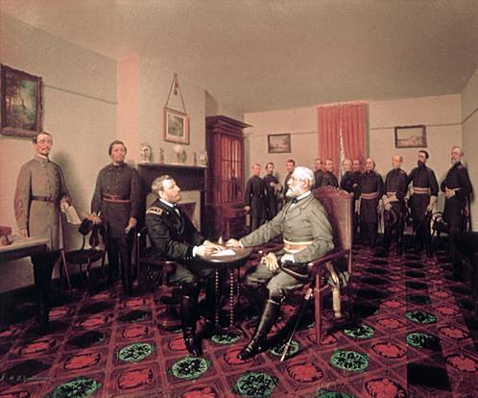
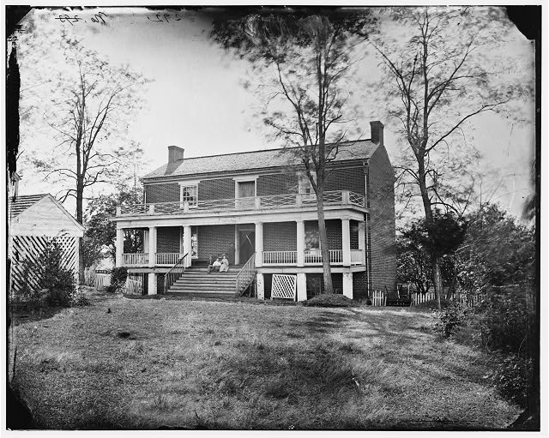
“There is nothing left for me to do but go and see General Grant, and I would rather die a thousand deaths.” -Robert E. Lee
Lee surrendered to Grant at Appomattox Courthouse.
To Lee’s surprise, Grant allowed his men to keep their
personal weapons and horses. Additionally Grant sent
provisions for the Confederate forces.
“ The war is over, the rebels are our countrymen again.” -U.S. Grant

Slide 15
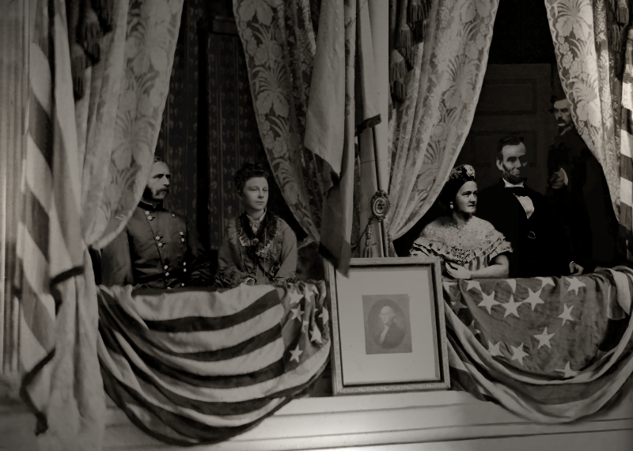
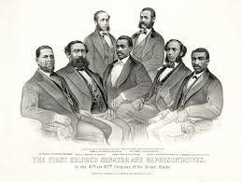
Reconstruction
The assassination of President Lincoln threw the nation into turmoil. Lincoln’s plan of Reconstruction fell to the new president, Andrew Johnson. Among aspects of Reconstruction was the passage of the 13th, 14th, and 15th Amendments. These abolished slavery, granted citizenship to the former slaves, and granted voting rights.

